Slide 1
SOFTer SKIN
Amy Kim
Andrea Najera
Shamanth Thenkan
Notes:
This is the cover template
You might change just the title and the team members names (do not change fonts or colors here)
In case you collect some videos together in a longer one, use this as introductory image (5 seconds)

Slide 2
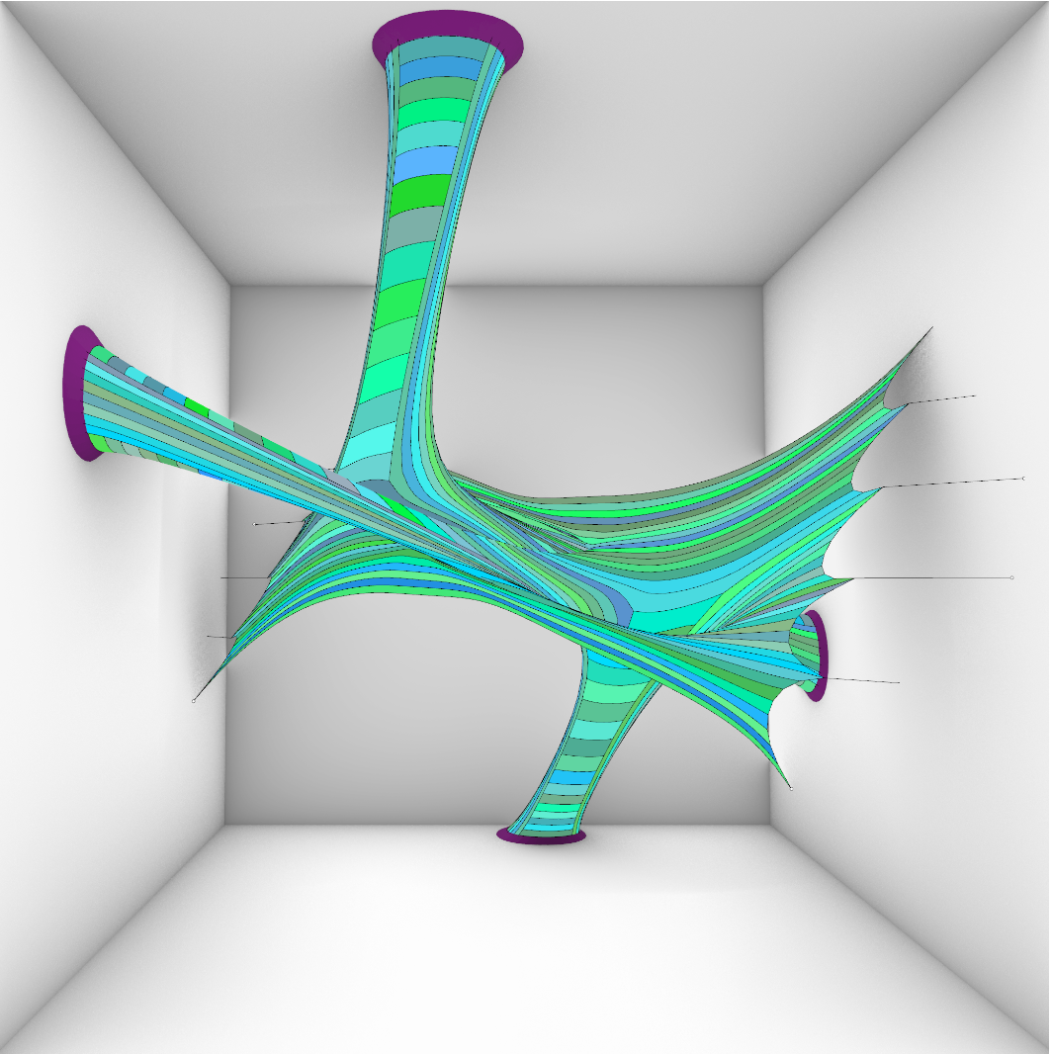

Slide 3
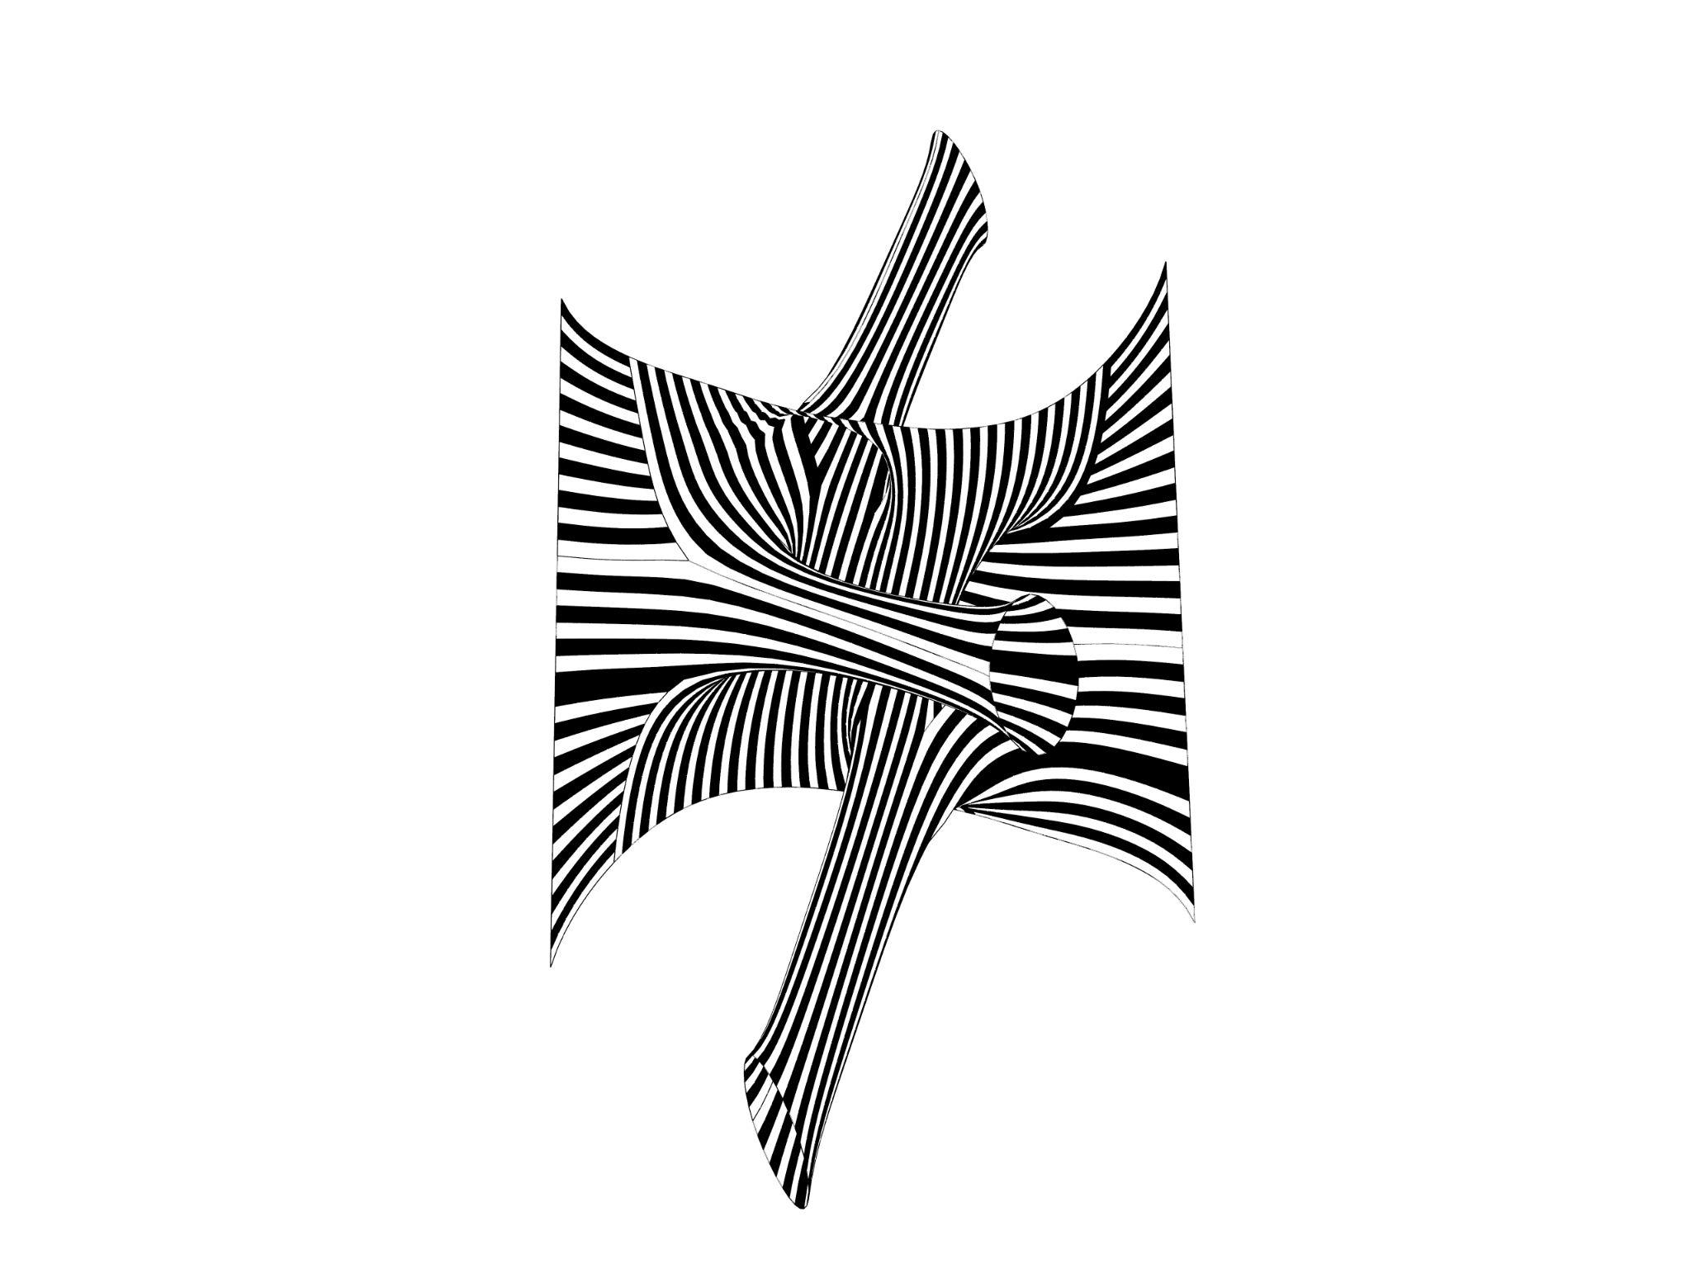
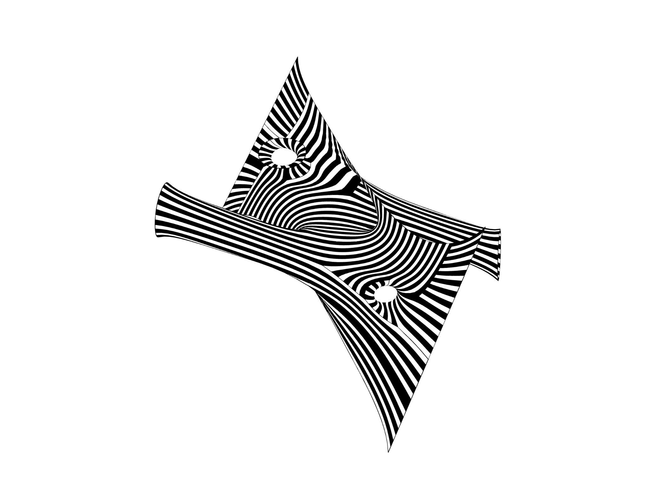
divide it, relax it, stripe it
and strip it.
SOFTer SKIN/ Amy Kim, Andrea Najera, Shamanth Thenkan
Notes:
Empty white slide template
Fill in your project title and the team members names

Slide 4
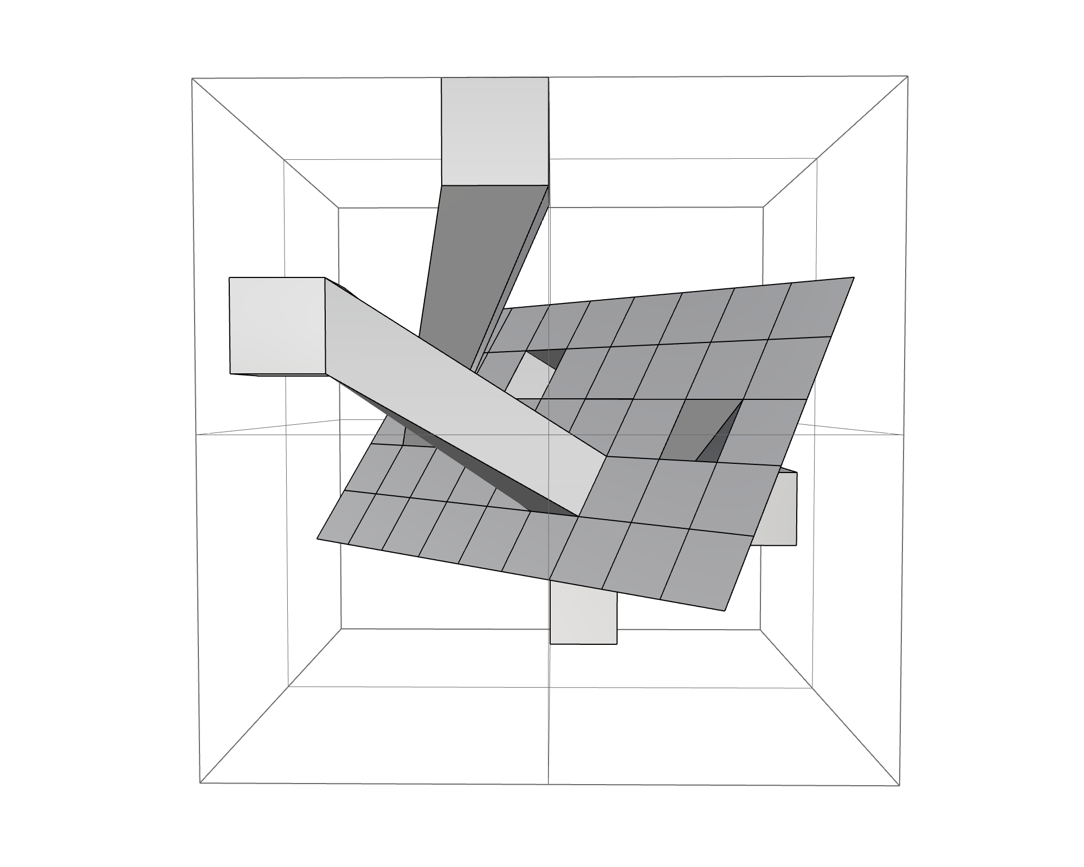
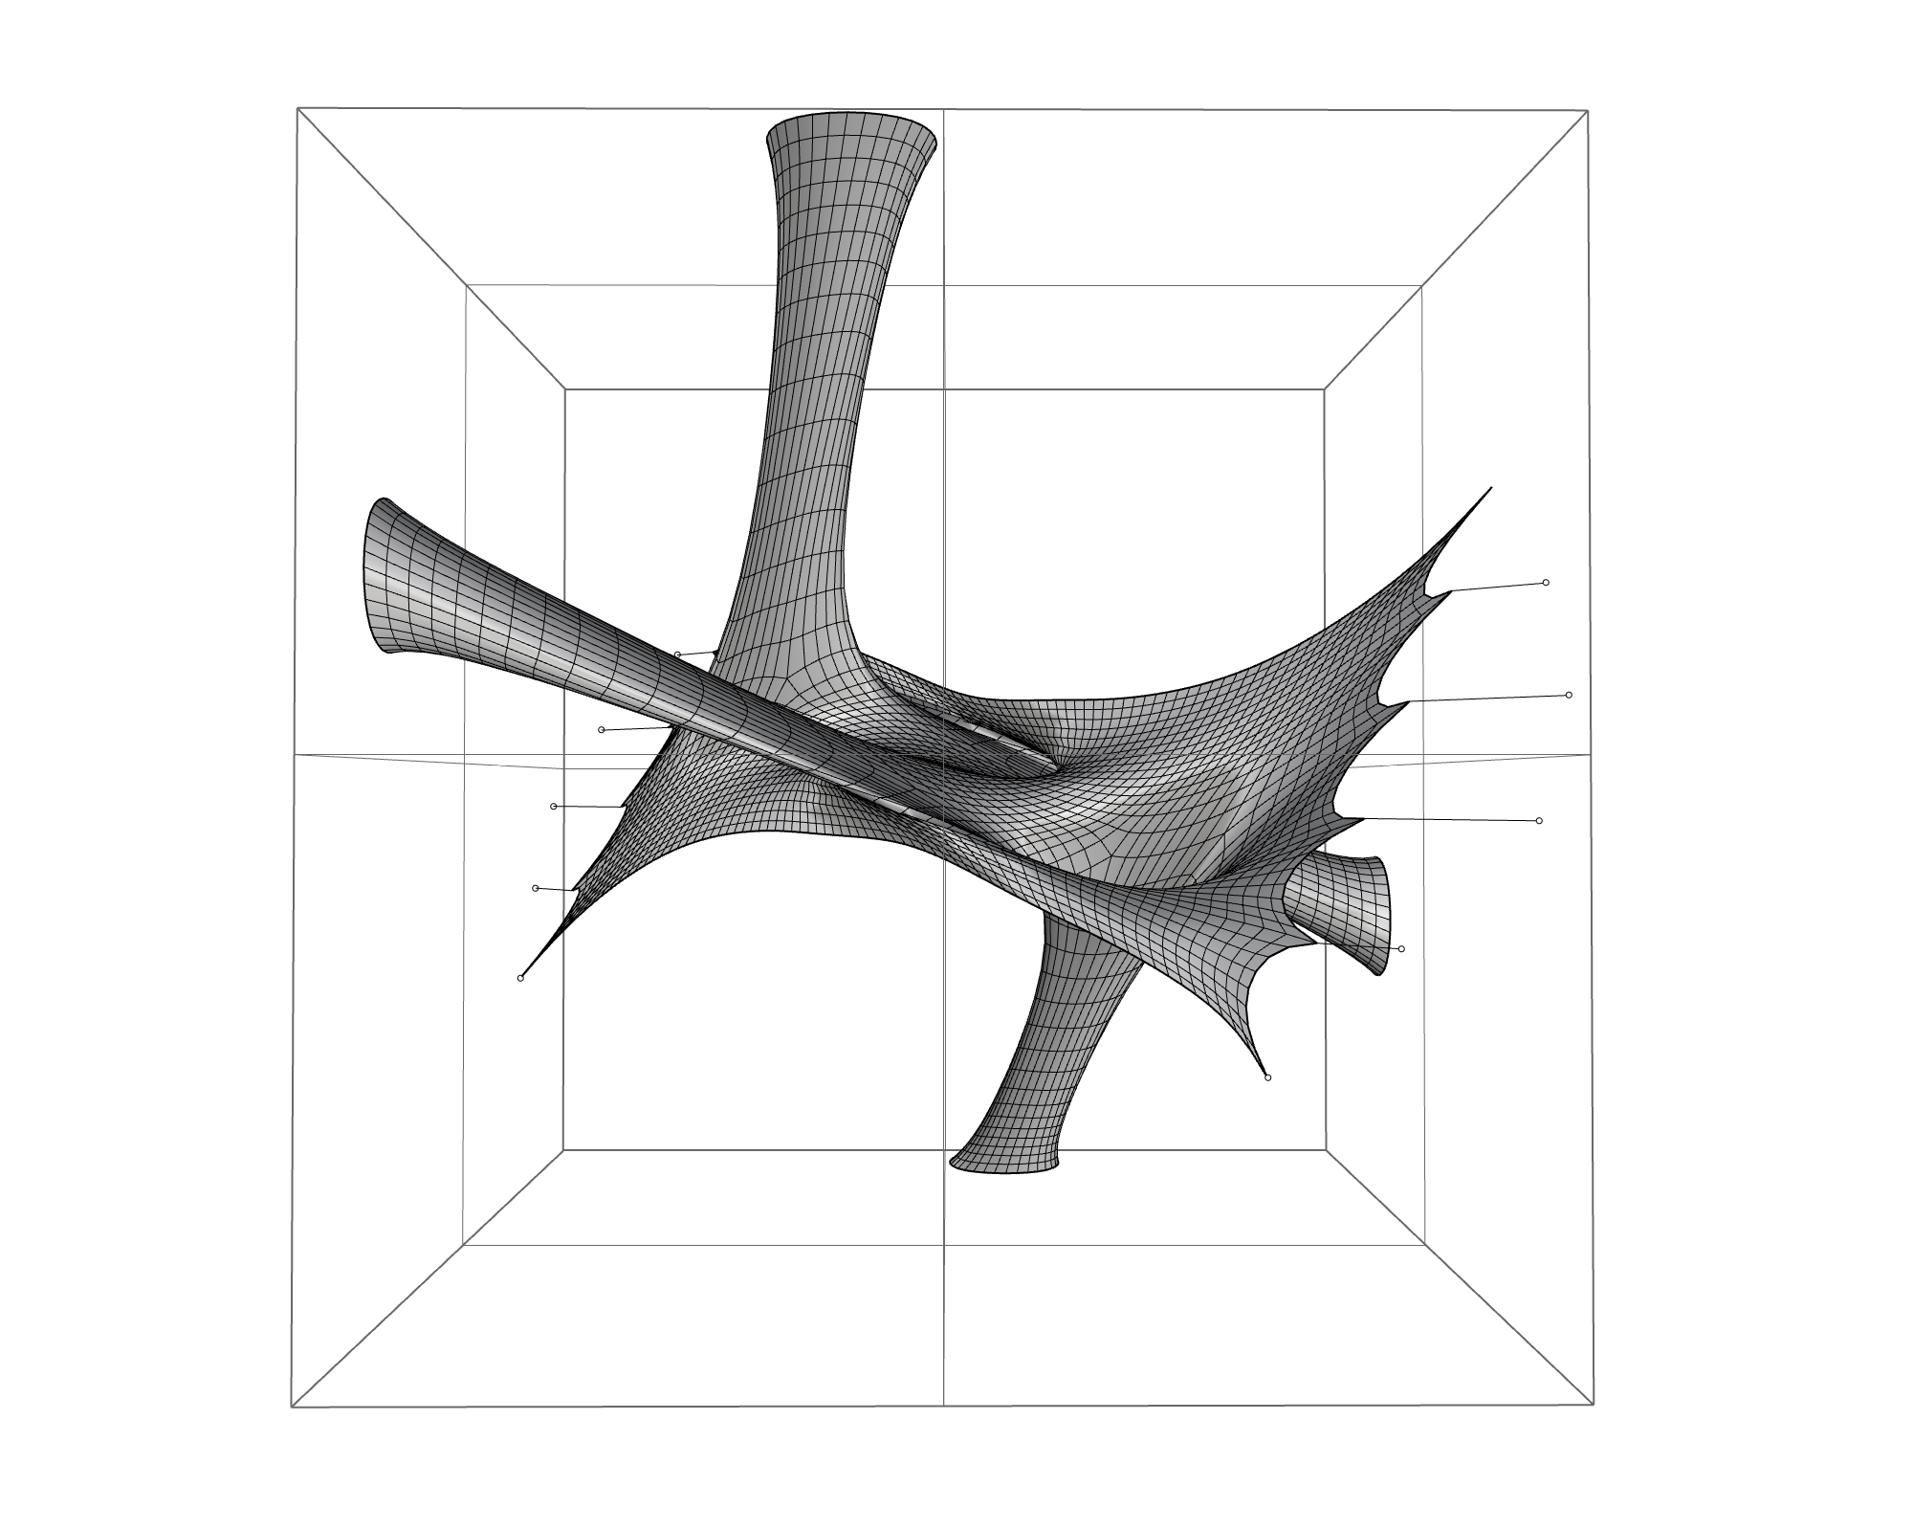
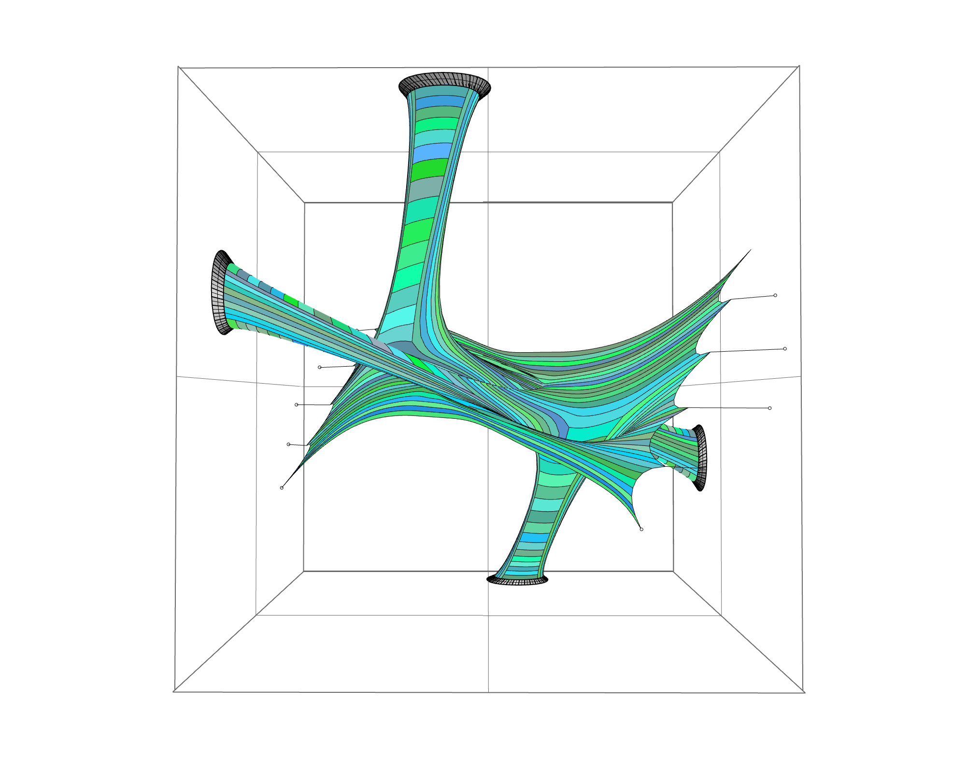
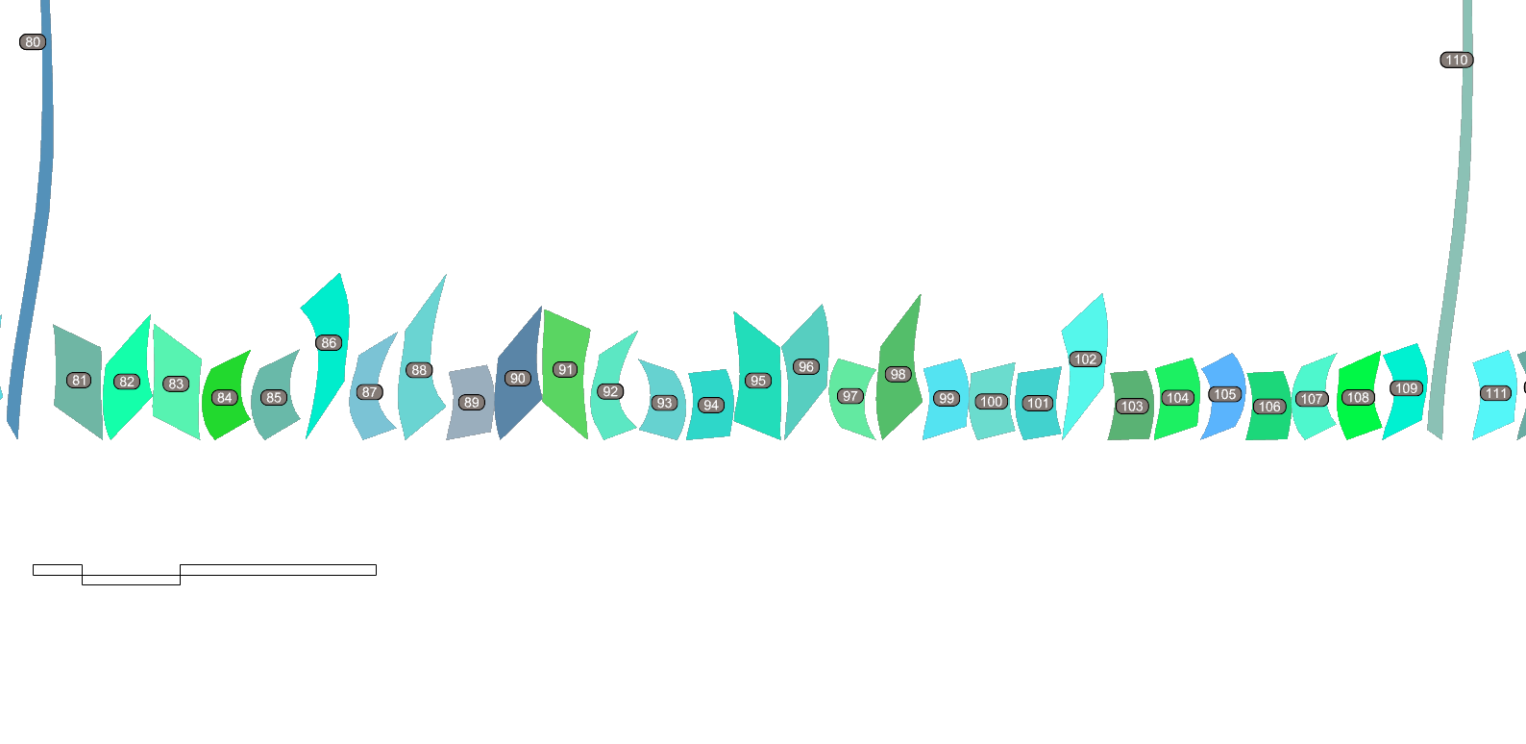
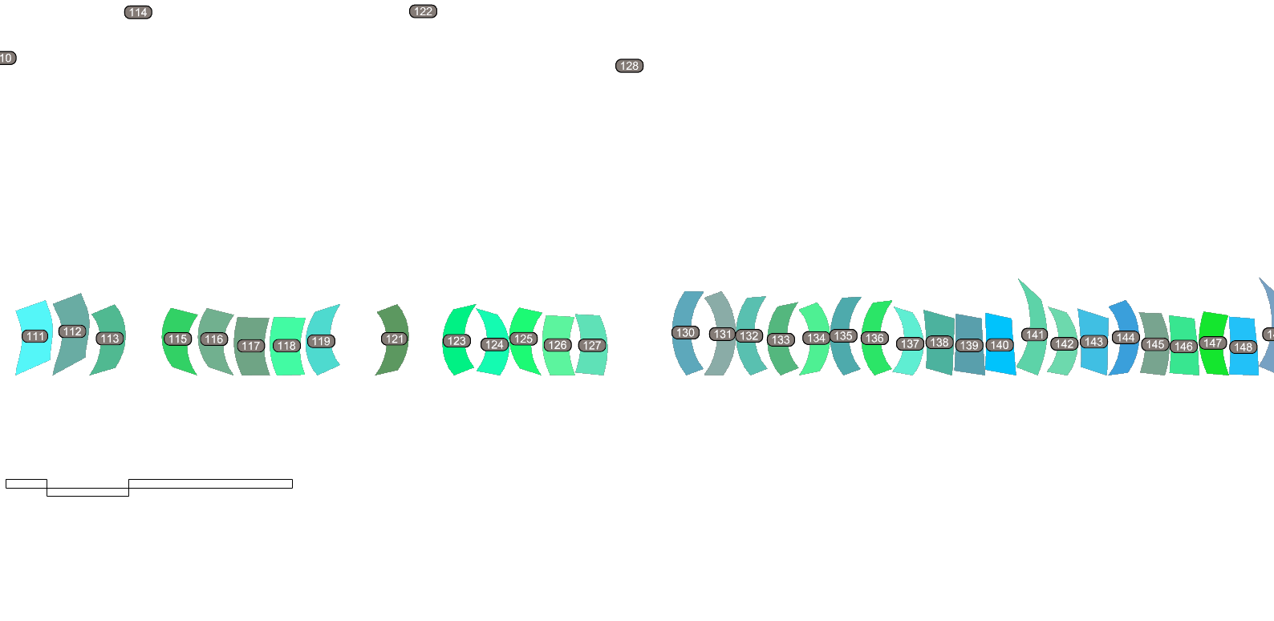
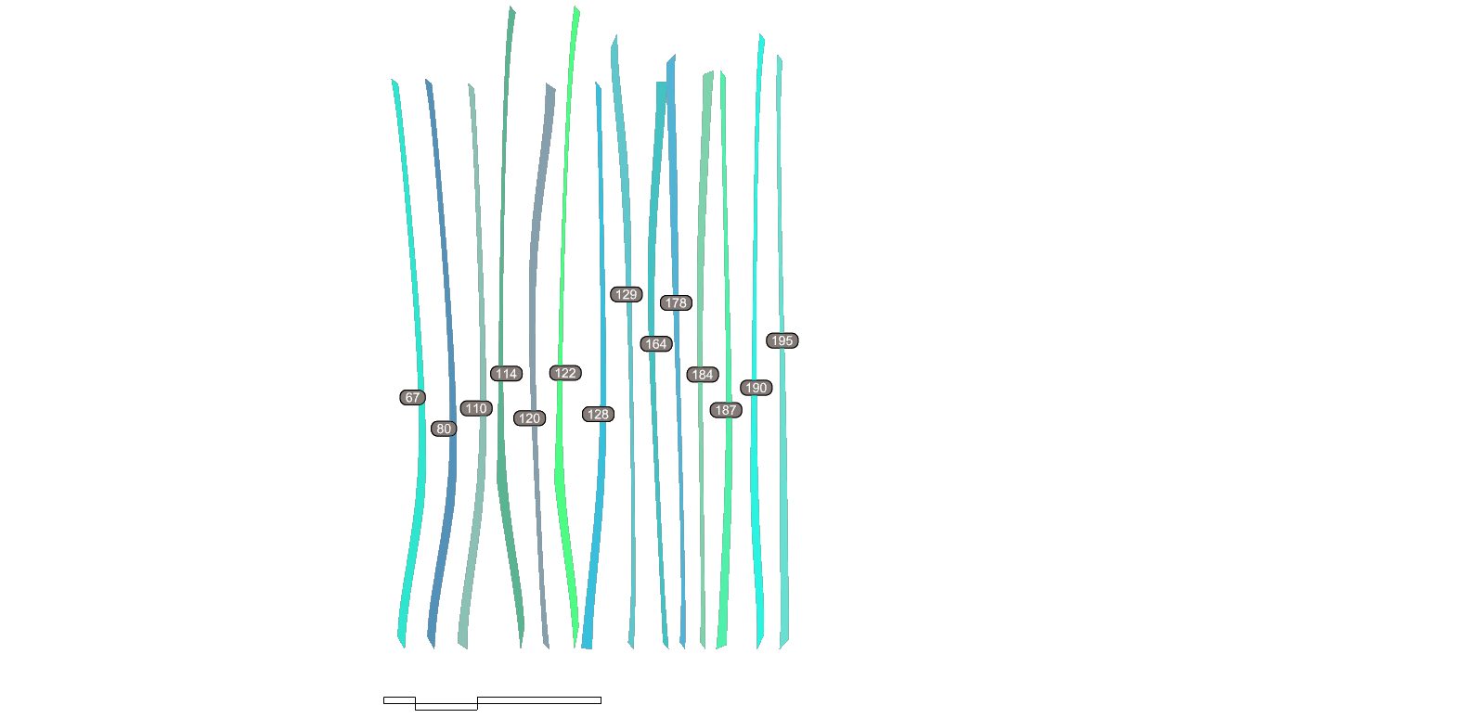
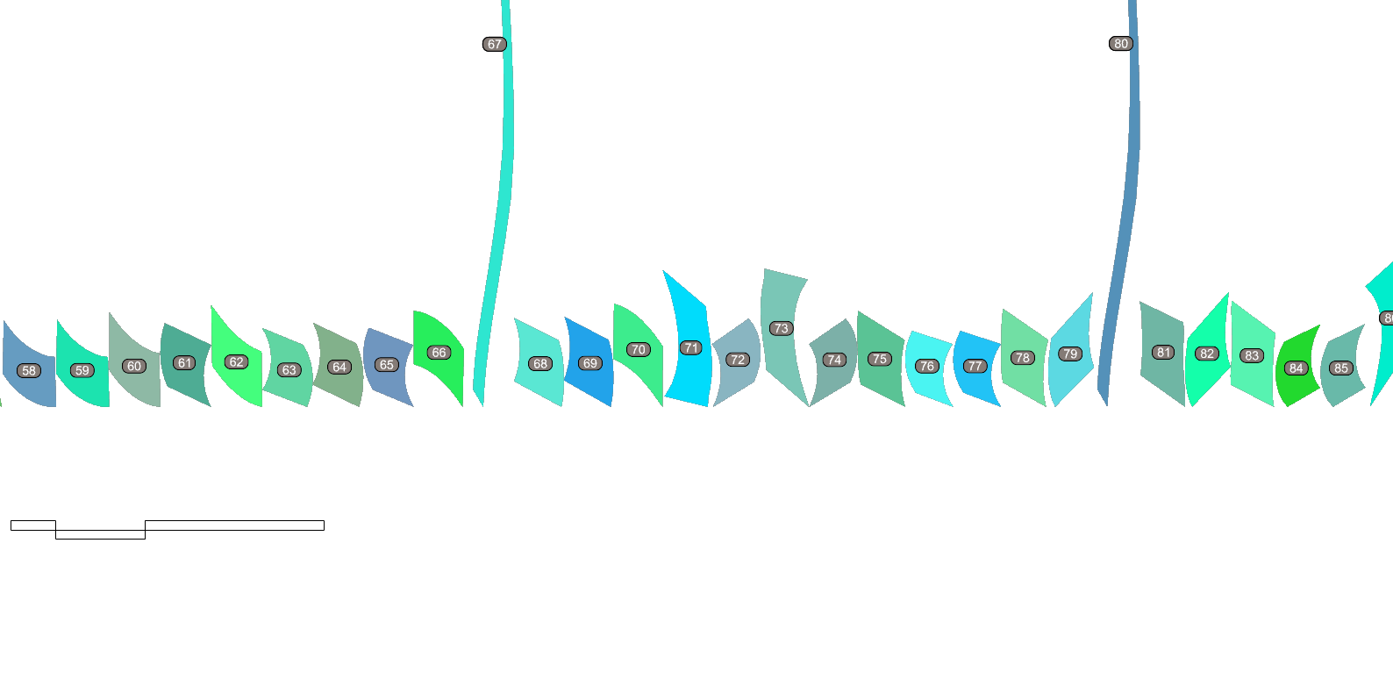
MESH FACES
SUB D MSB
STRIPING MESH
1 - Geometry
2 - SubD + Relax Mesh
3 - Stripe
4- Fabrication
How to make your skin softer, week by week
Notes:
The present and the following slides (slide 4 to 10) contain some indications and examples, do not include any of these in your final presentation

Slide 5
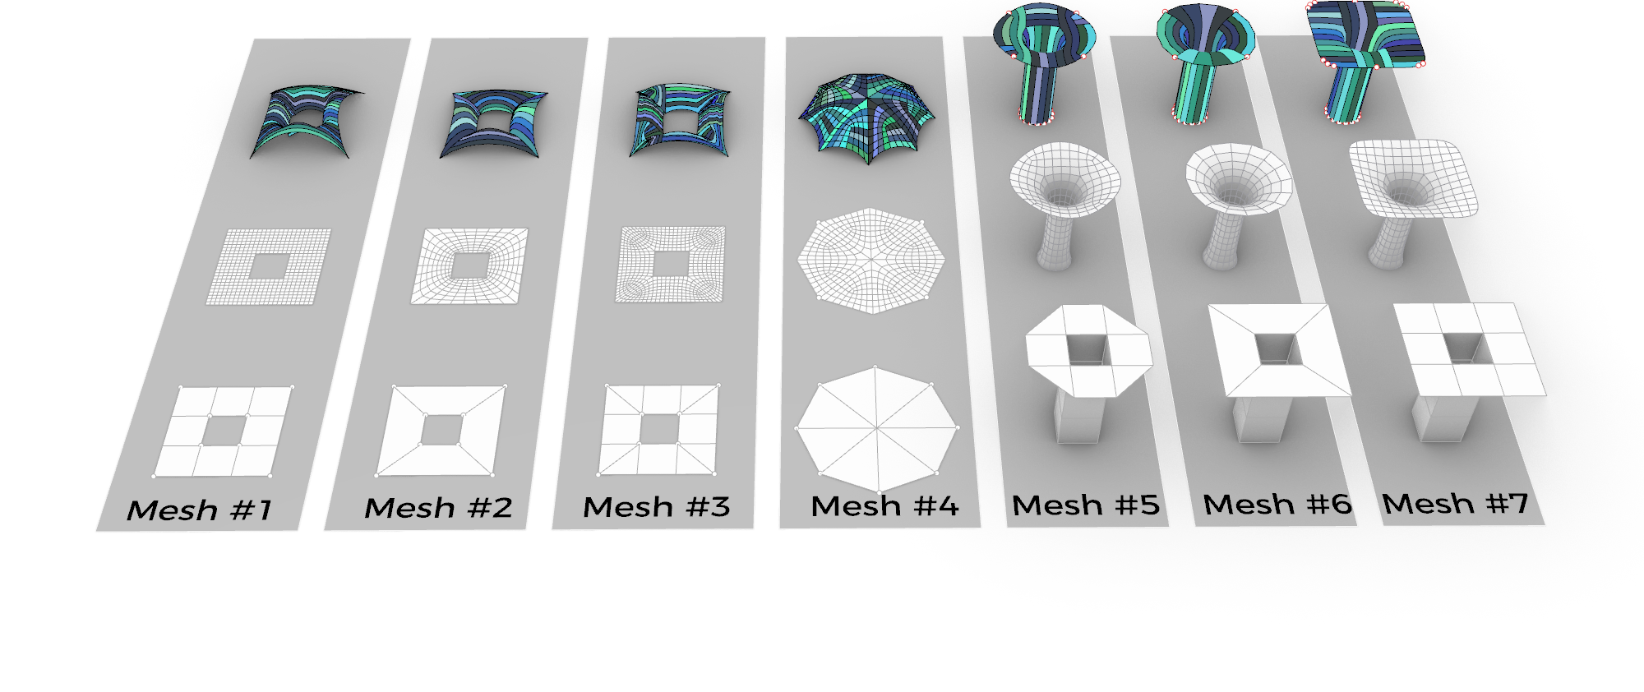

1 - INITIAL EXPLORATION
Three team members explored different mesh geometries, their relaxation and stripping. We were attracted to the relaxation of surfaces, but also the stripping pattern formed from surface and solid connections.
SOFTer SKIN/ Amy Kim, Andrea Najera, Shamanth Thenkan

Slide 6
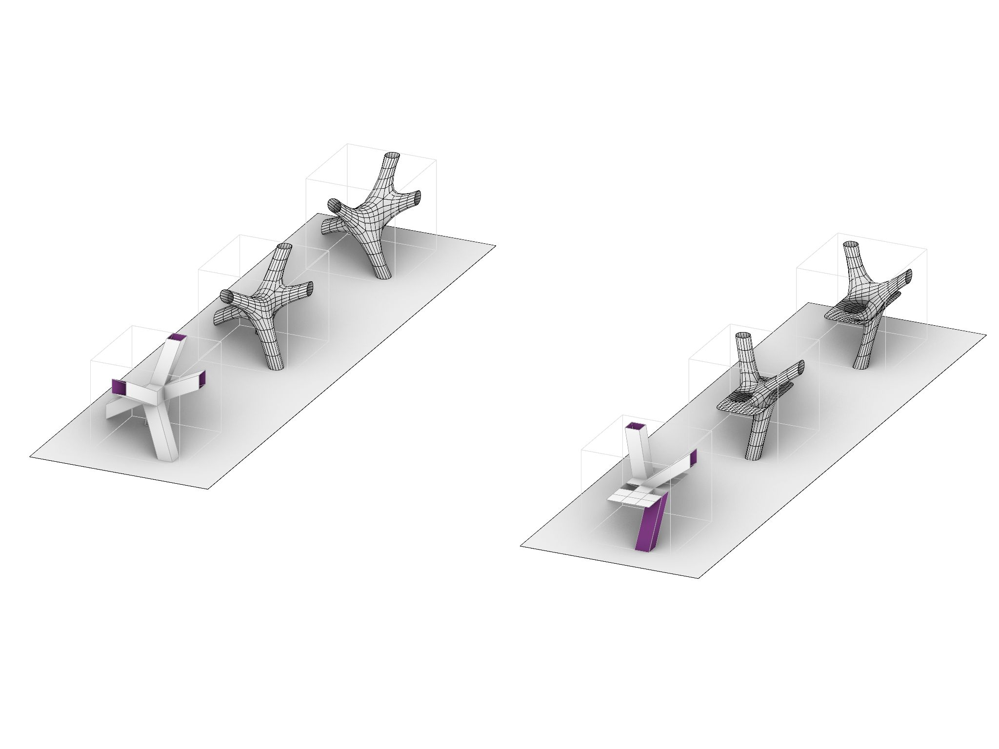
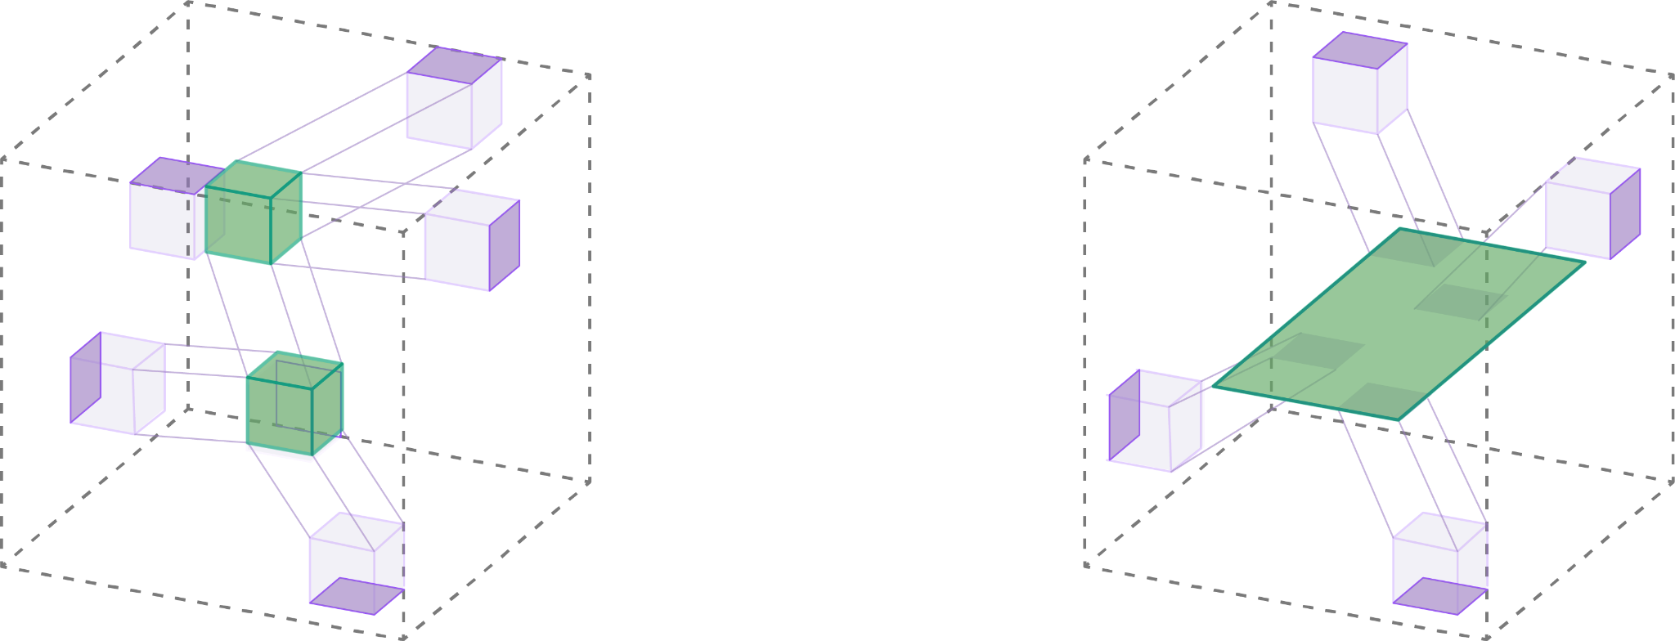
Solid to Solid
Solid to Surface
NODES
SURFACE
ANCHOR POINTS
ANCHOR POINTS
2 - CONCEPT
There is a room. There are anchor points on the walls of the room. We want to define a mesh geometry connecting to these points, and do so in two ways. .
SOFTer SKIN/ Amy Kim, Andrea Najera, Shamanth Thenkan3

Slide 7
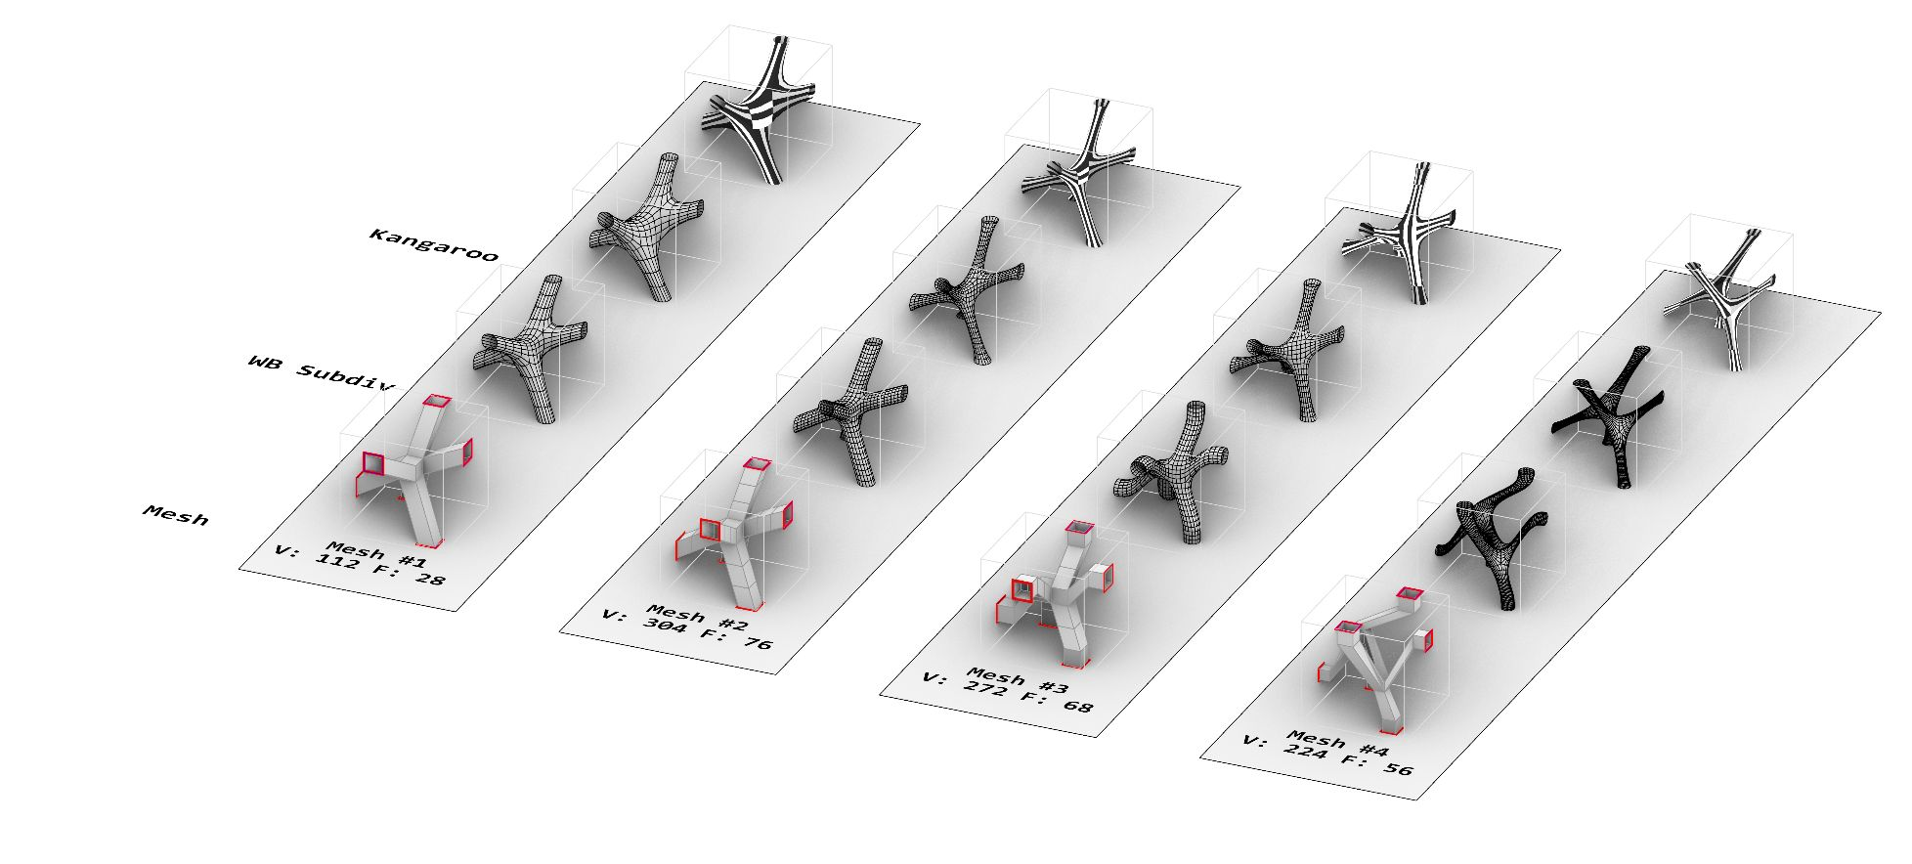
Solid to Solid
2 - SOLID TO SOLID
We begin with 4 different types of mesh geometries with solid to solid connections.
SOFTer SKIN/ Amy Kim, Andrea Najera, Shamanth Thenkan3

Slide 8
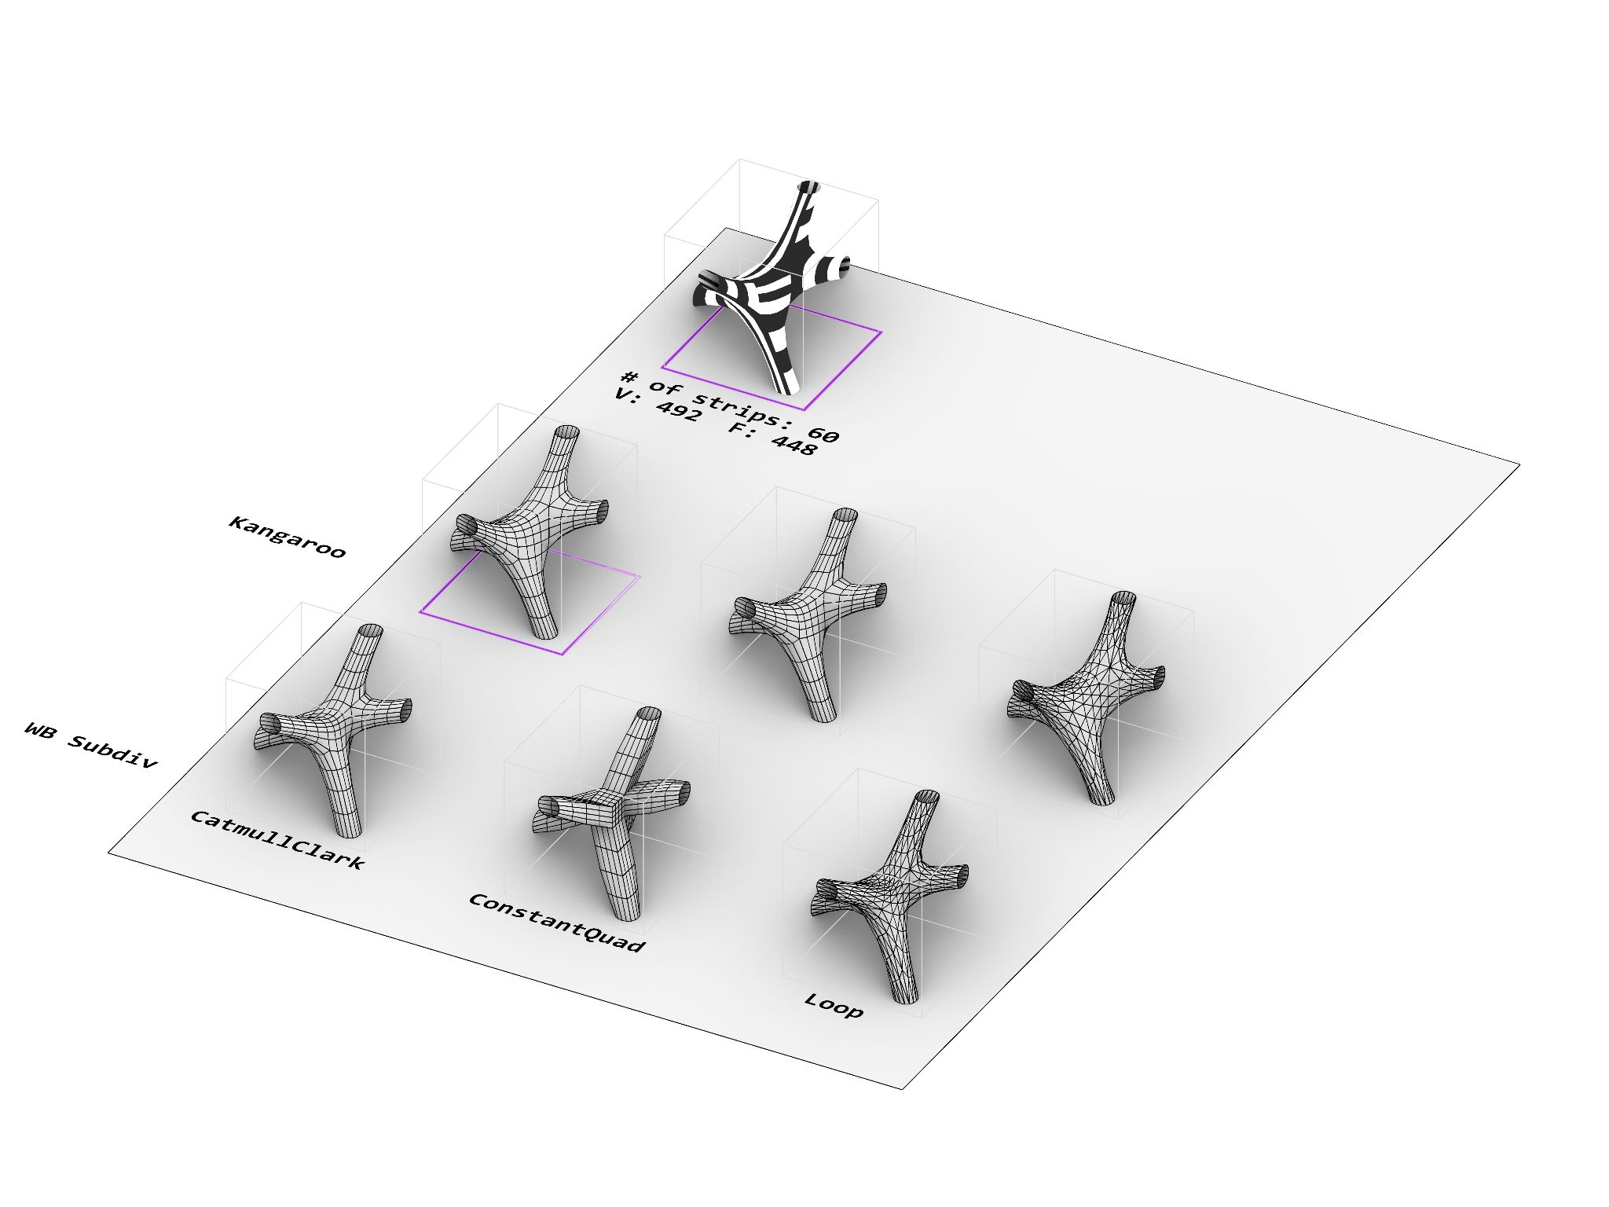
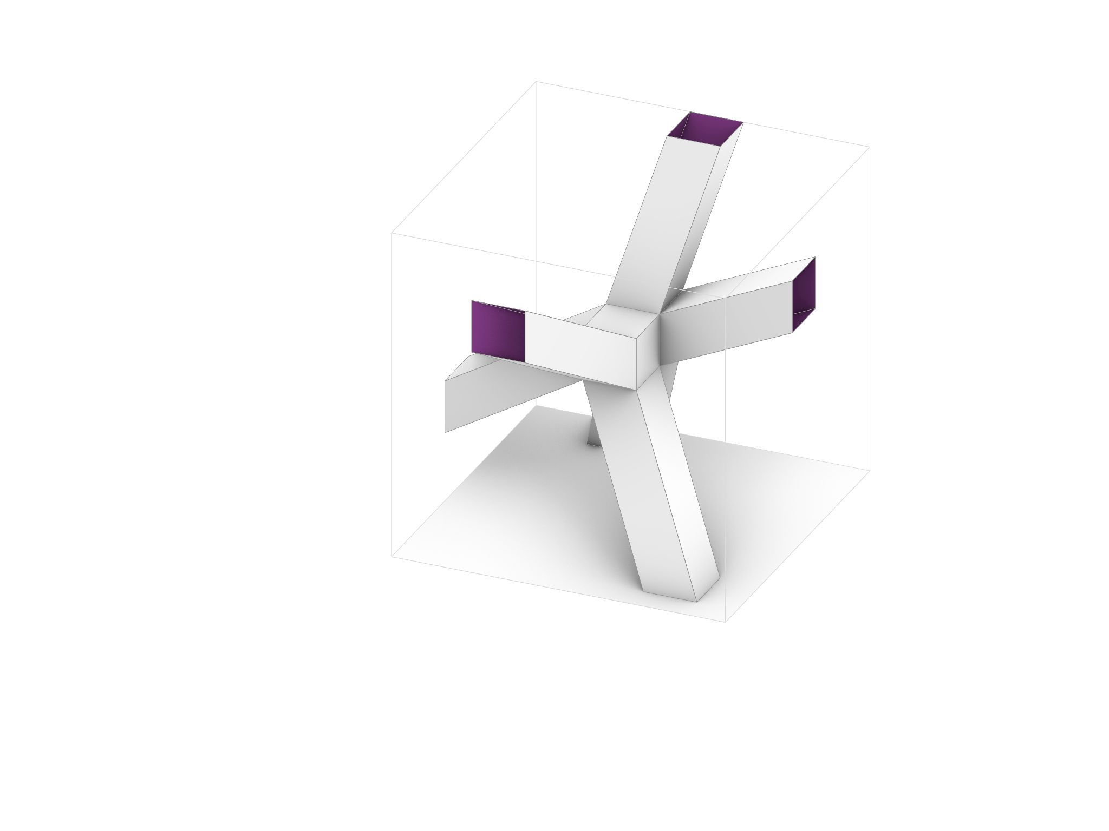
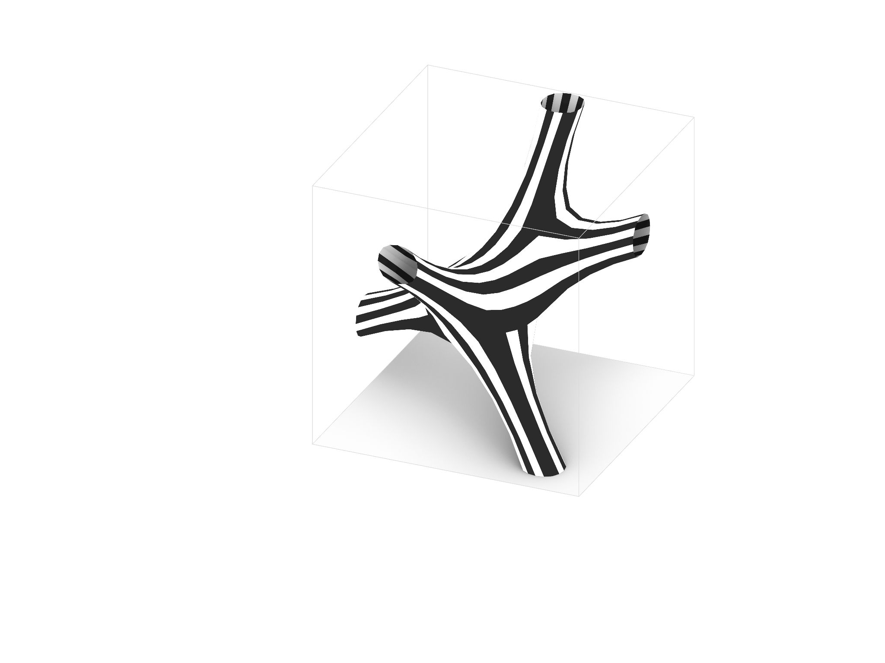
Mesh #1
Initial Geometry
Vertices: 112
Faces: 28
Re-stripped:
# of strips: 56
SOFTer SKIN/ Amy Kim, Andrea Najera, Shamanth Thenkan3

Slide 9
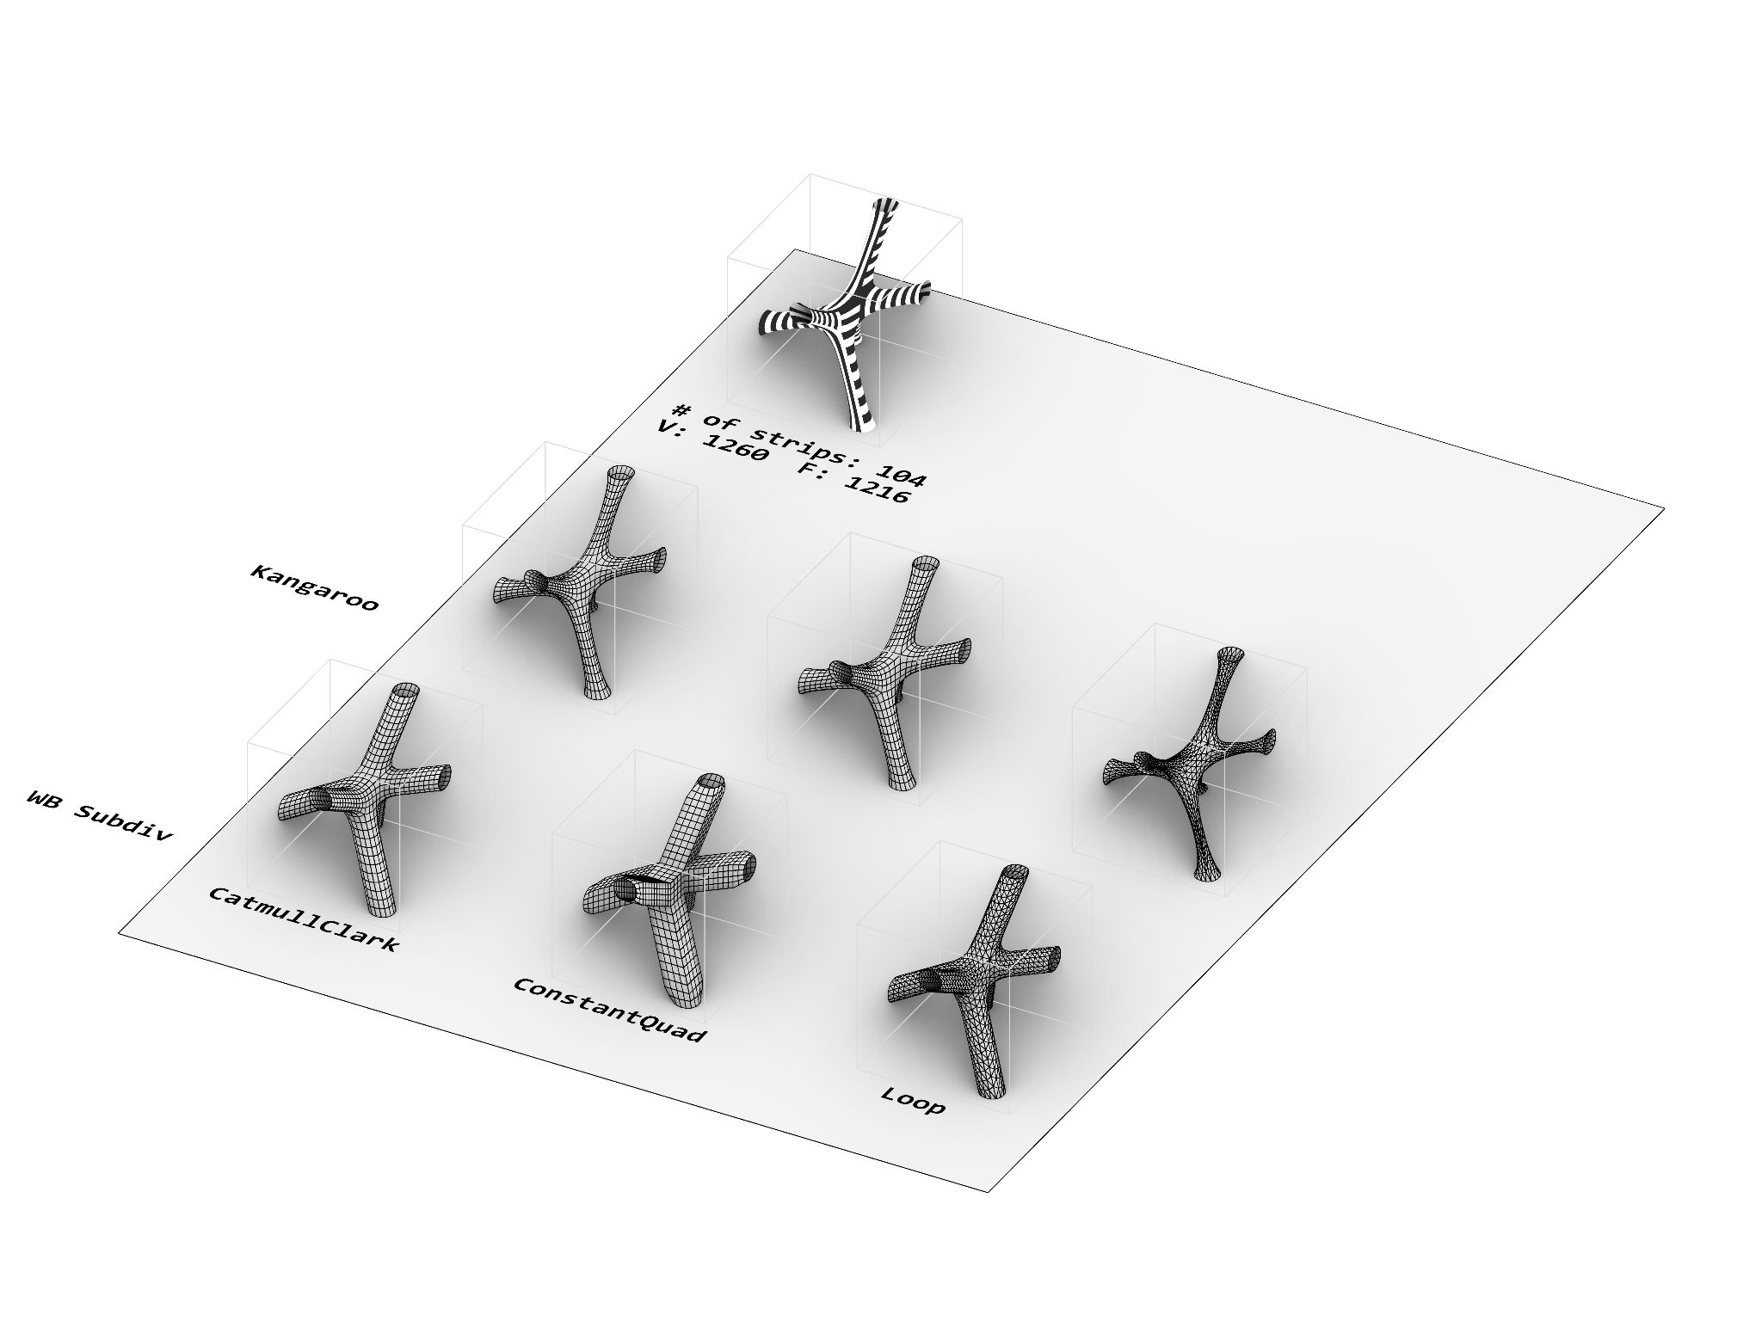
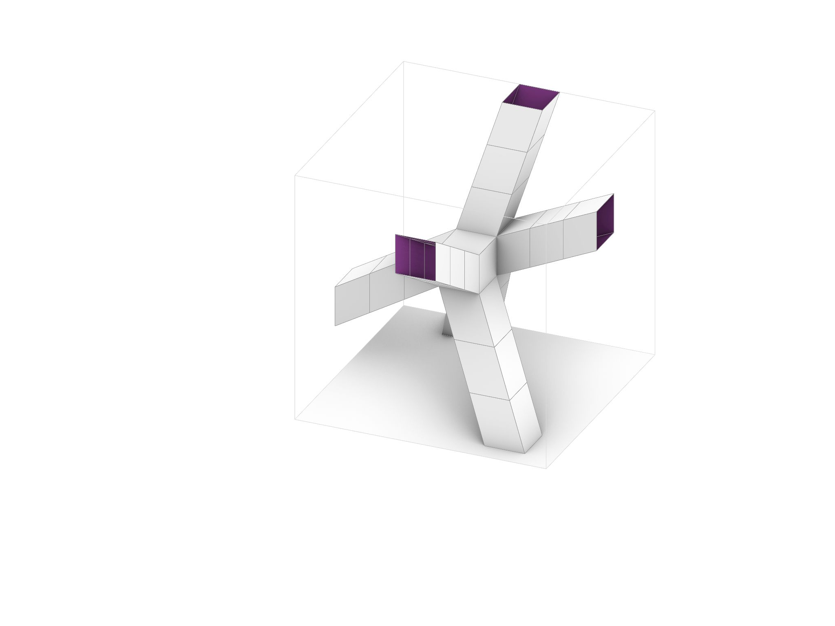
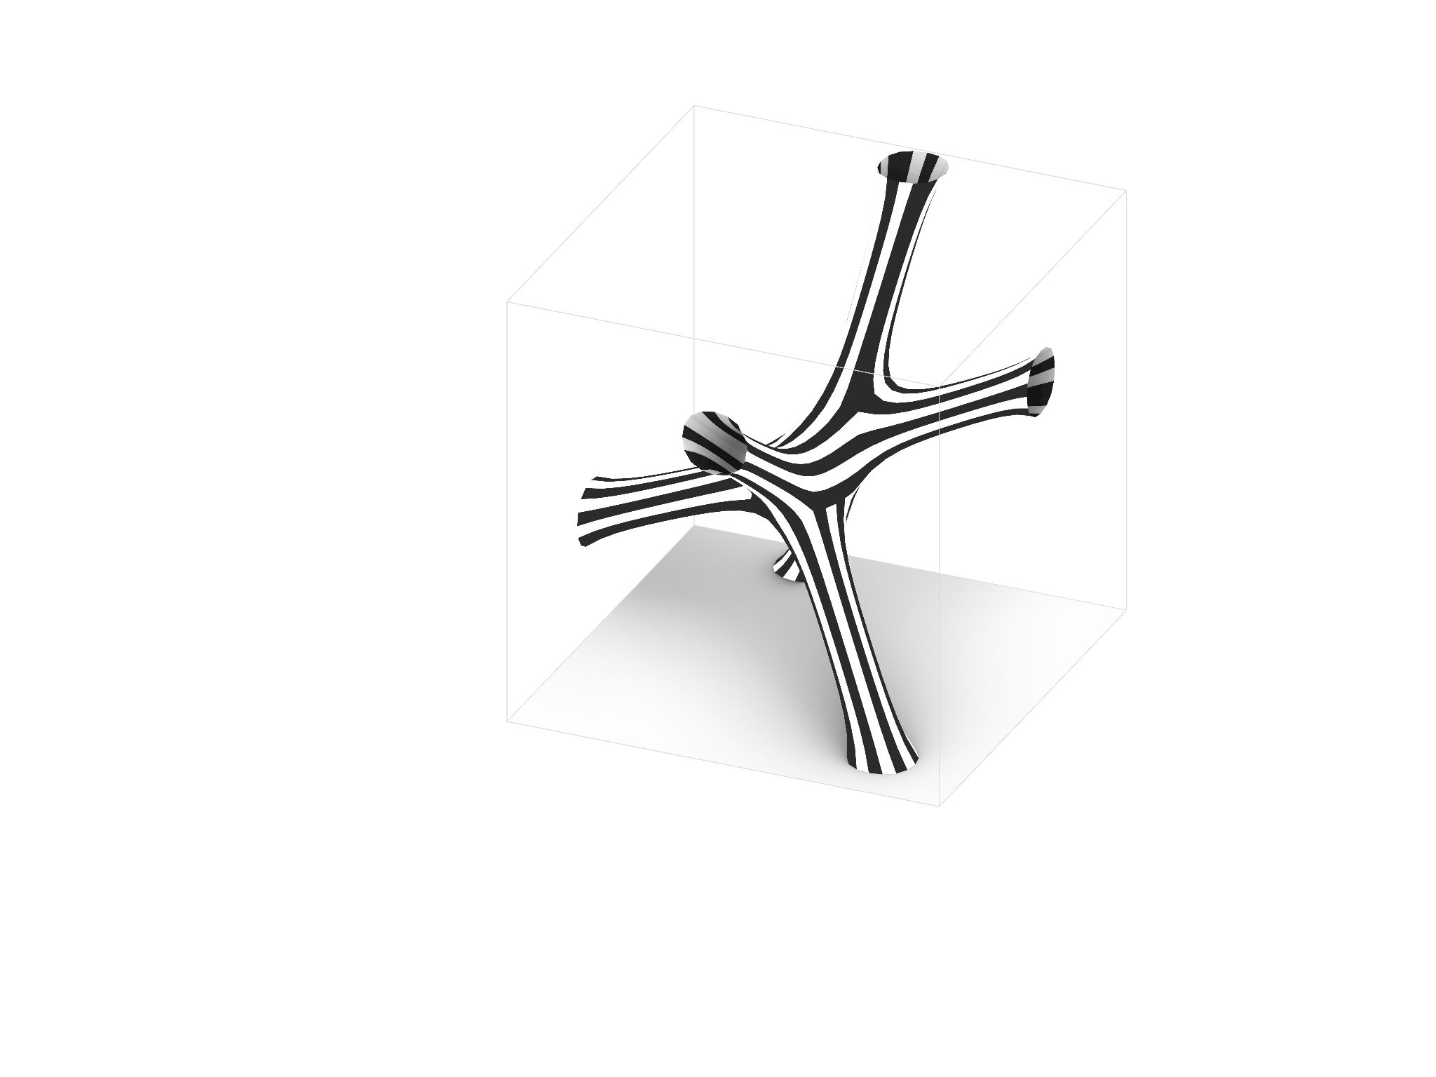
Mesh #2
Initial Geometry
Vertices: 304
Faces: 76
Re-stripped:
# of strips: 56
SOFTer SKIN/ Amy Kim, Andrea Najera, Shamanth Thenkan3

Slide 10

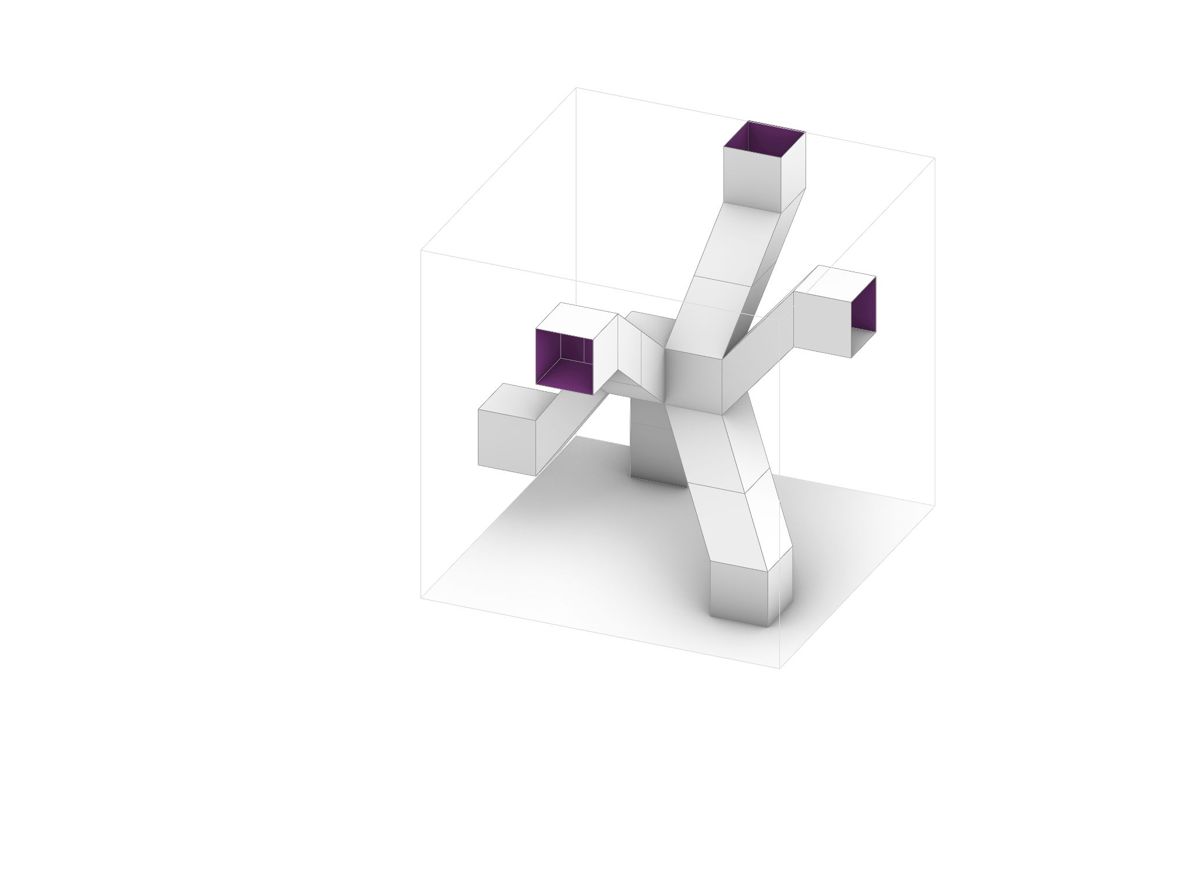
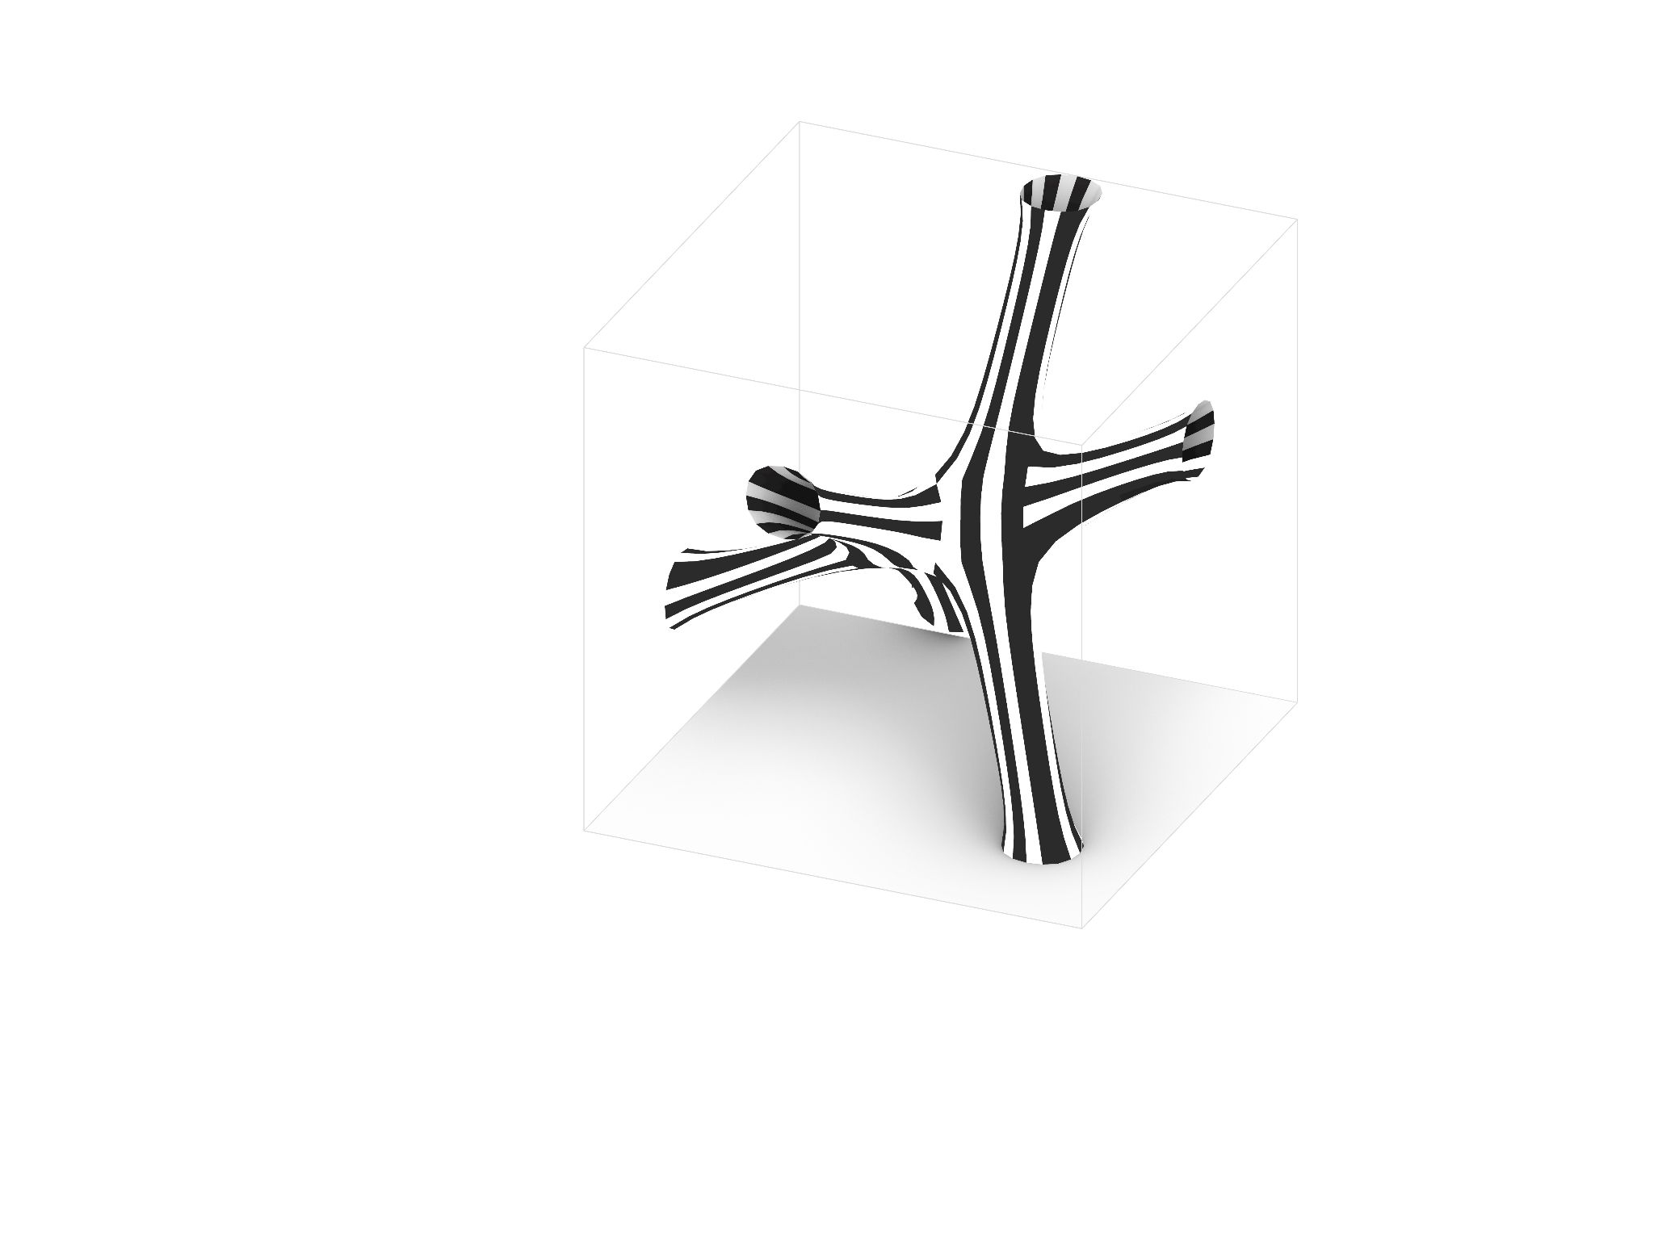
Mesh #3
Mesh #3
Initial Geometry
Vertices: 272
Faces: 68
Initial Geometry
Vertices: 272
Faces: 68
Re-stripped:
# of strips: 68
SOFTer SKIN/ Amy Kim, Andrea Najera, Shamanth Thenkan3

Slide 11

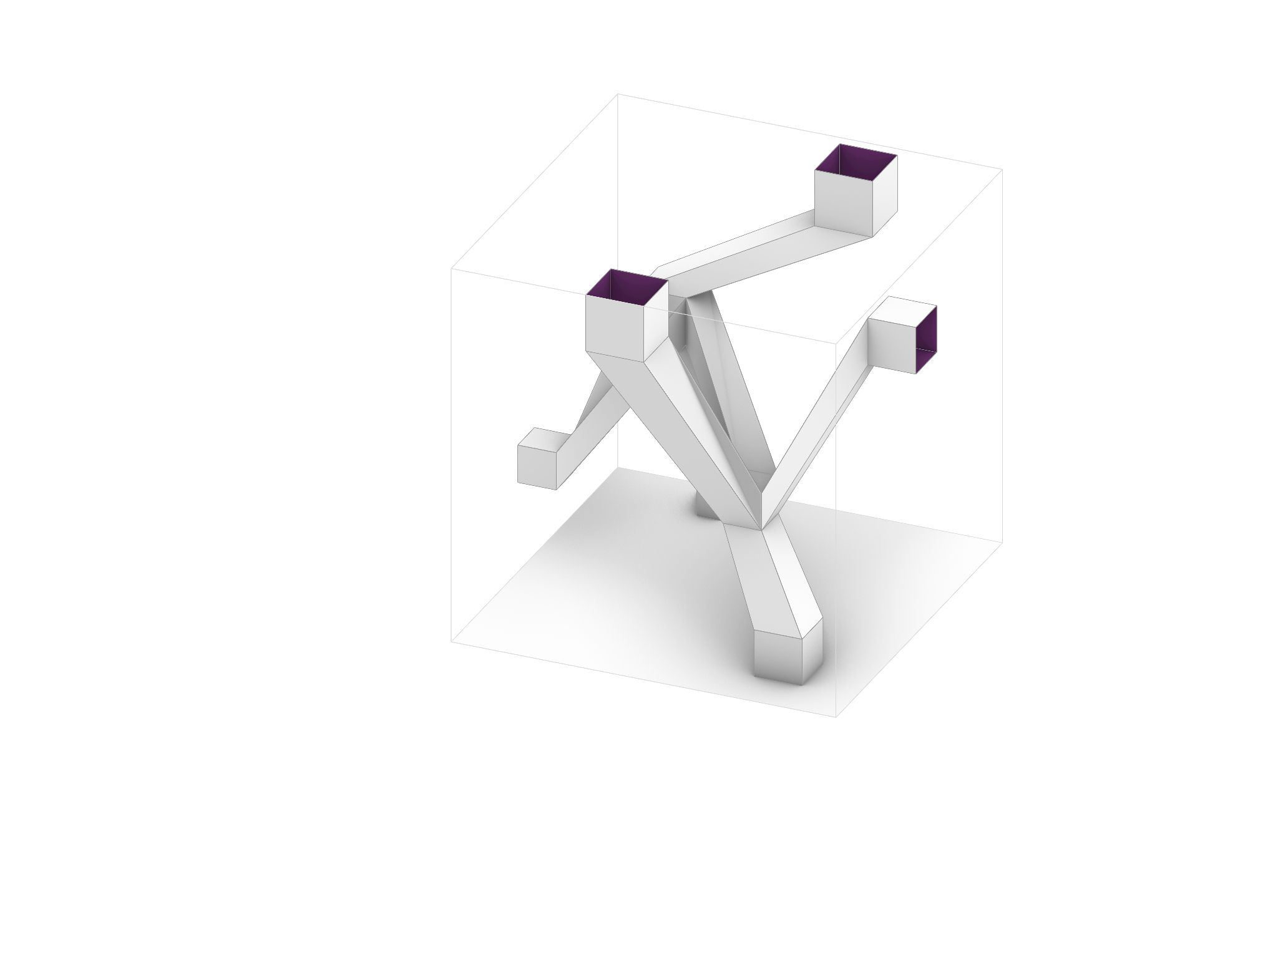
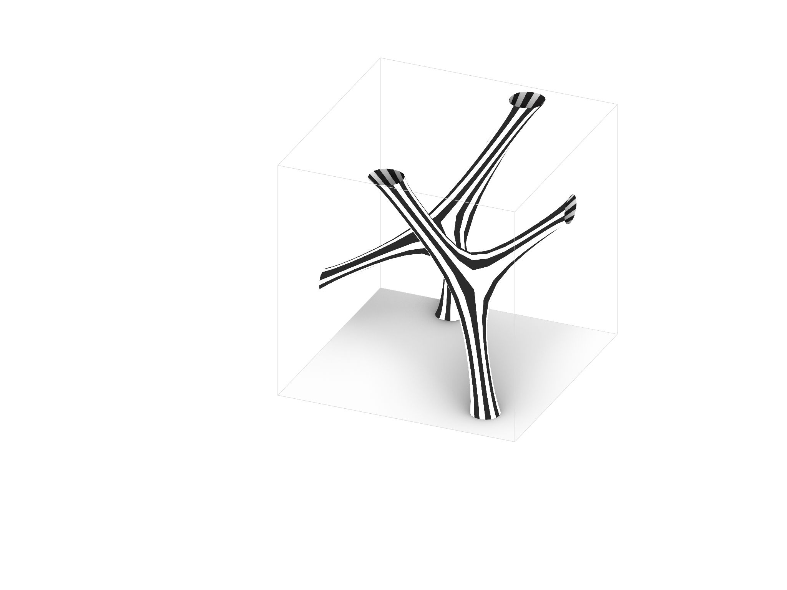
Mesh #4
Initial Geometry
Vertices: 224
Faces: 56
Re-stripped:
# of strips: 68
SOFTer SKIN/ Amy Kim, Andrea Najera, Shamanth Thenkan3

Slide 12
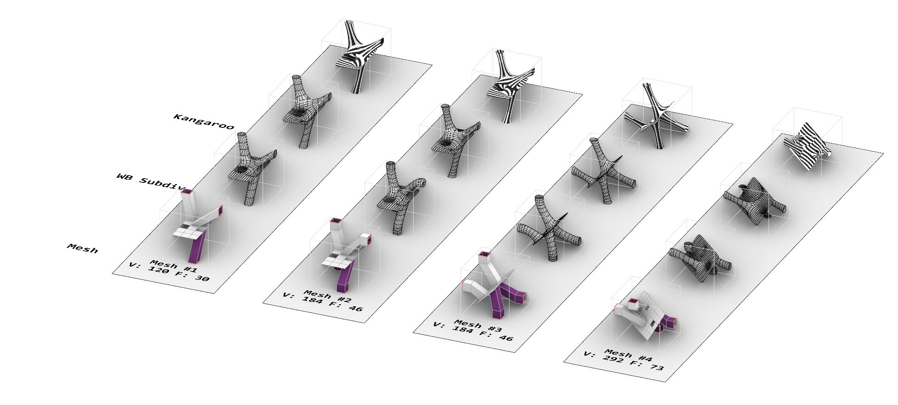
Surface to Solid
2 - SURFACE TO SOLID
Following four mesh geometries explore different orientation and connection.
SOFTer SKIN/ Amy Kim, Andrea Najera, Shamanth Thenkan

Slide 13

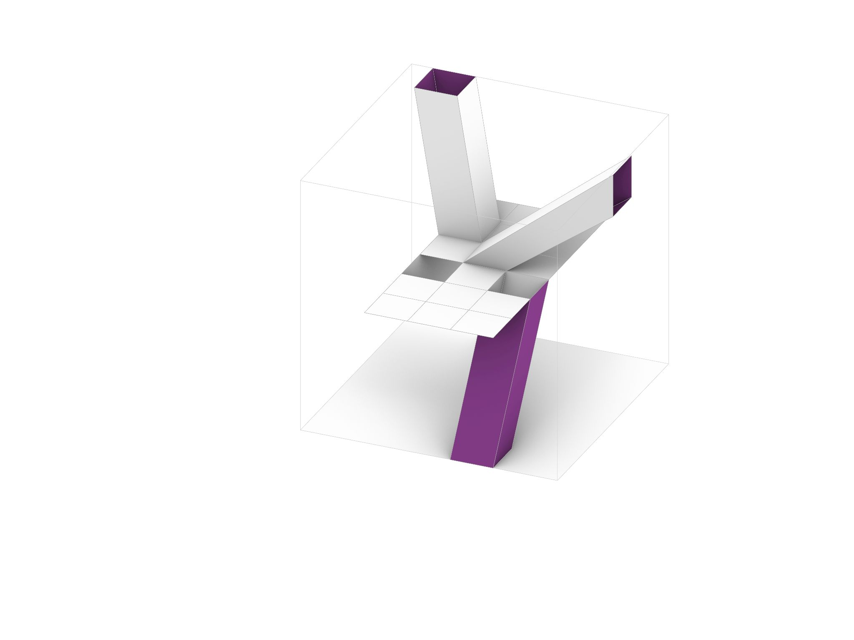
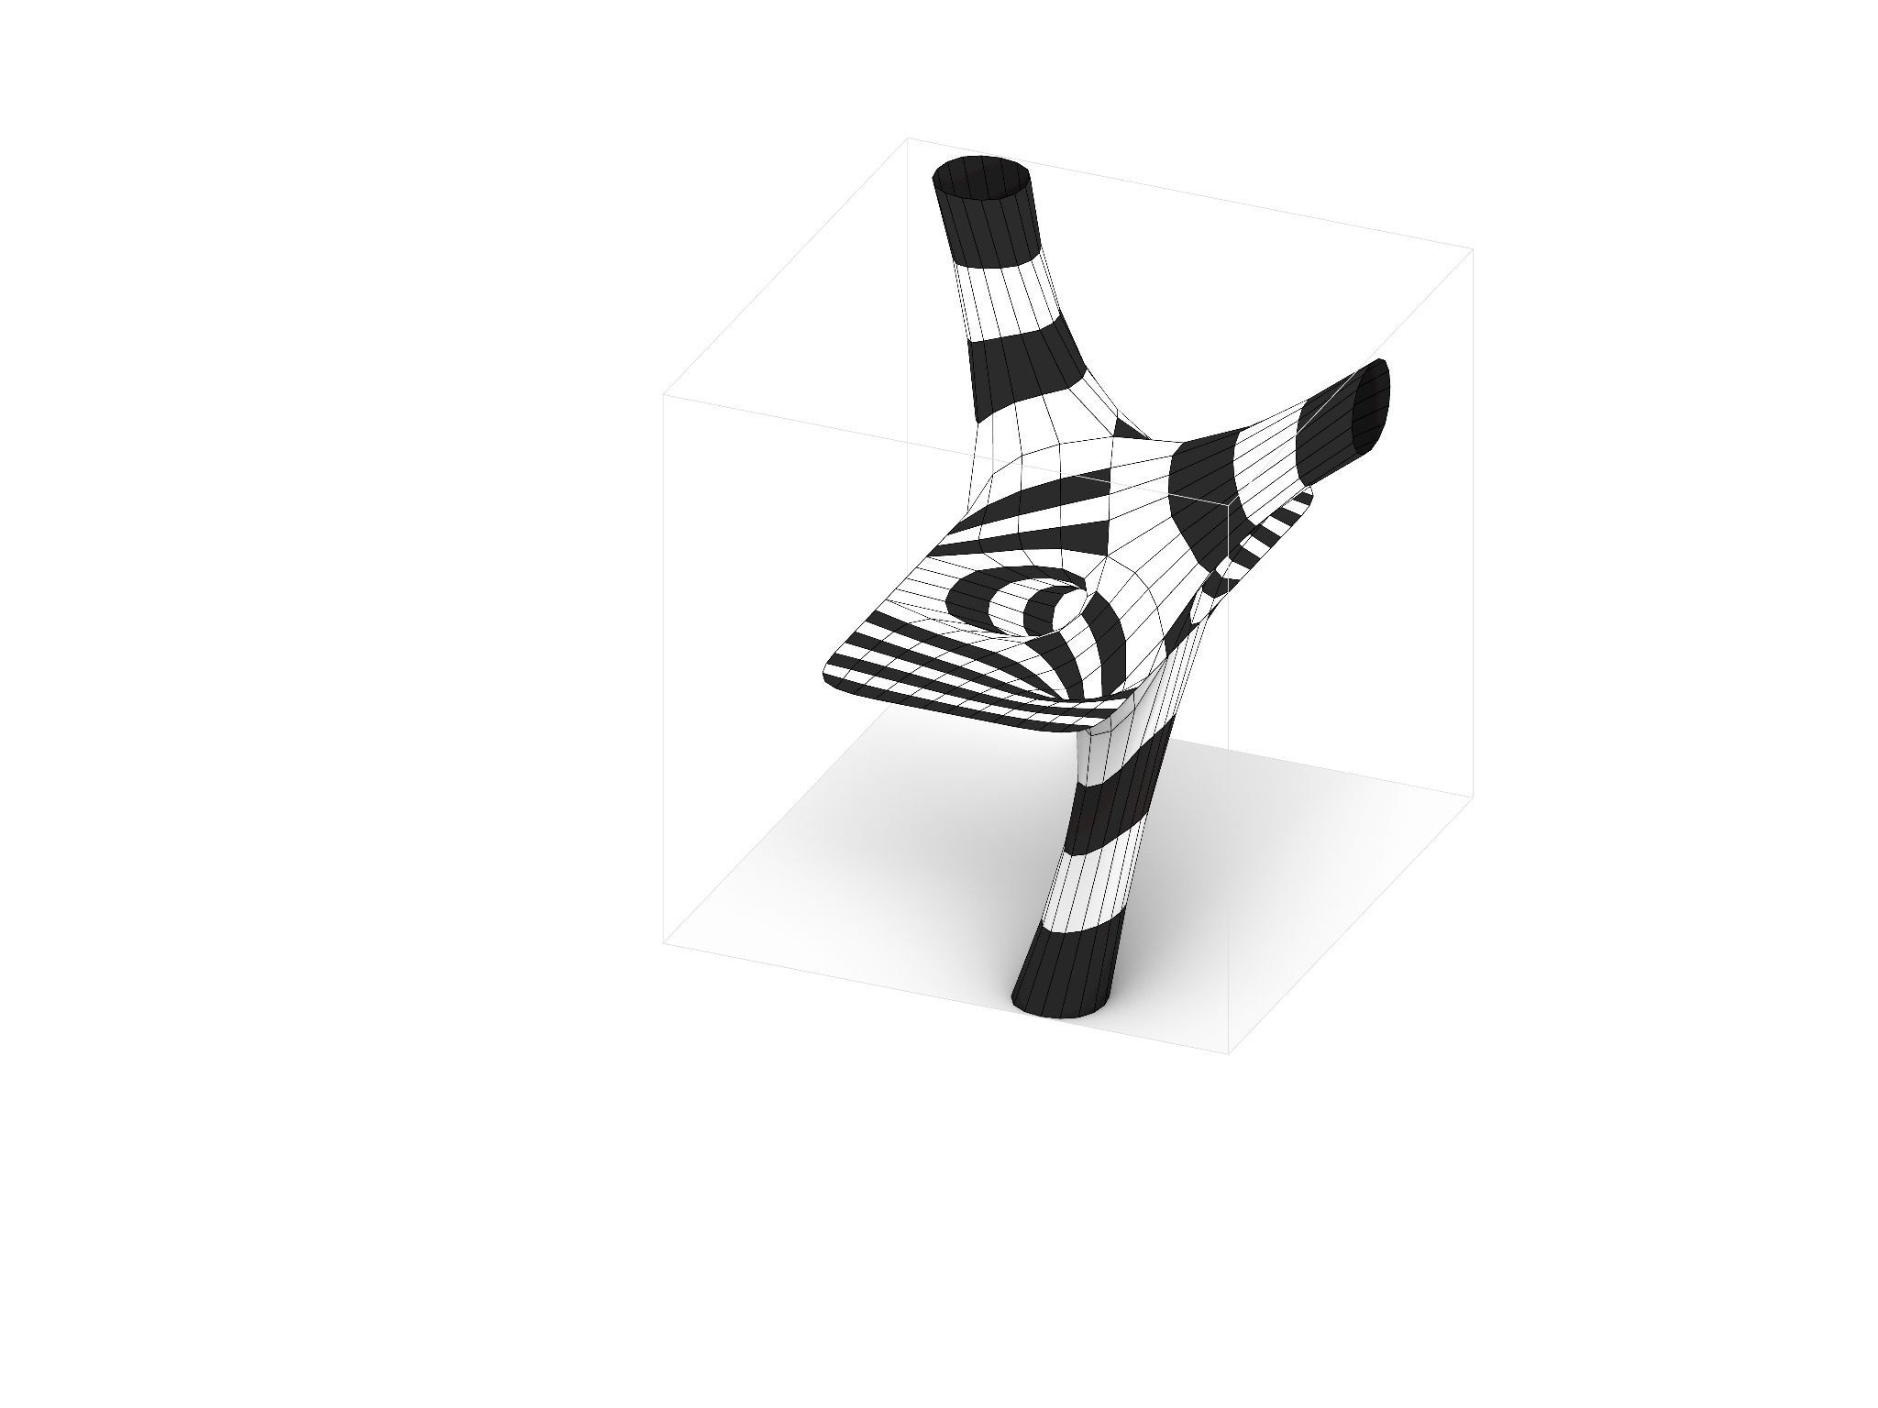
Mesh #1
Initial Geometry
Vertices: 120
Faces: 30
Re-stripped:
# of strips: 48
SOFTer SKIN/ Amy Kim, Andrea Najera, Shamanth Thenkan

Slide 14

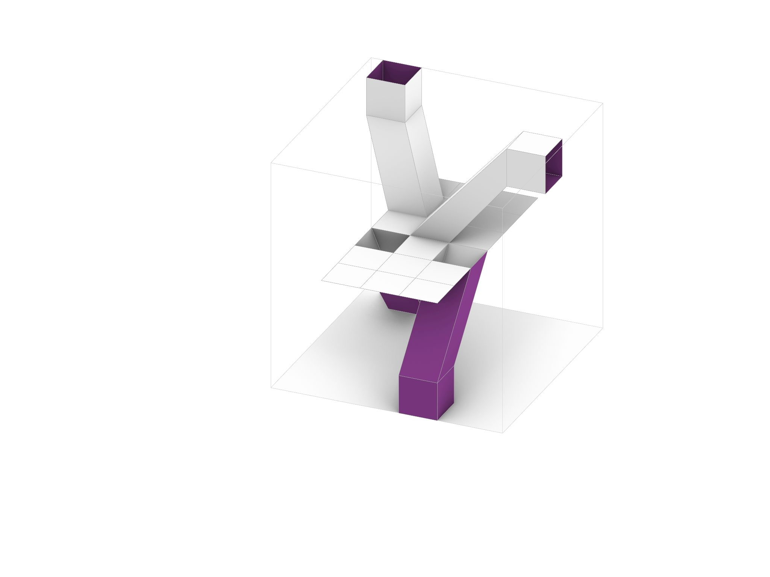
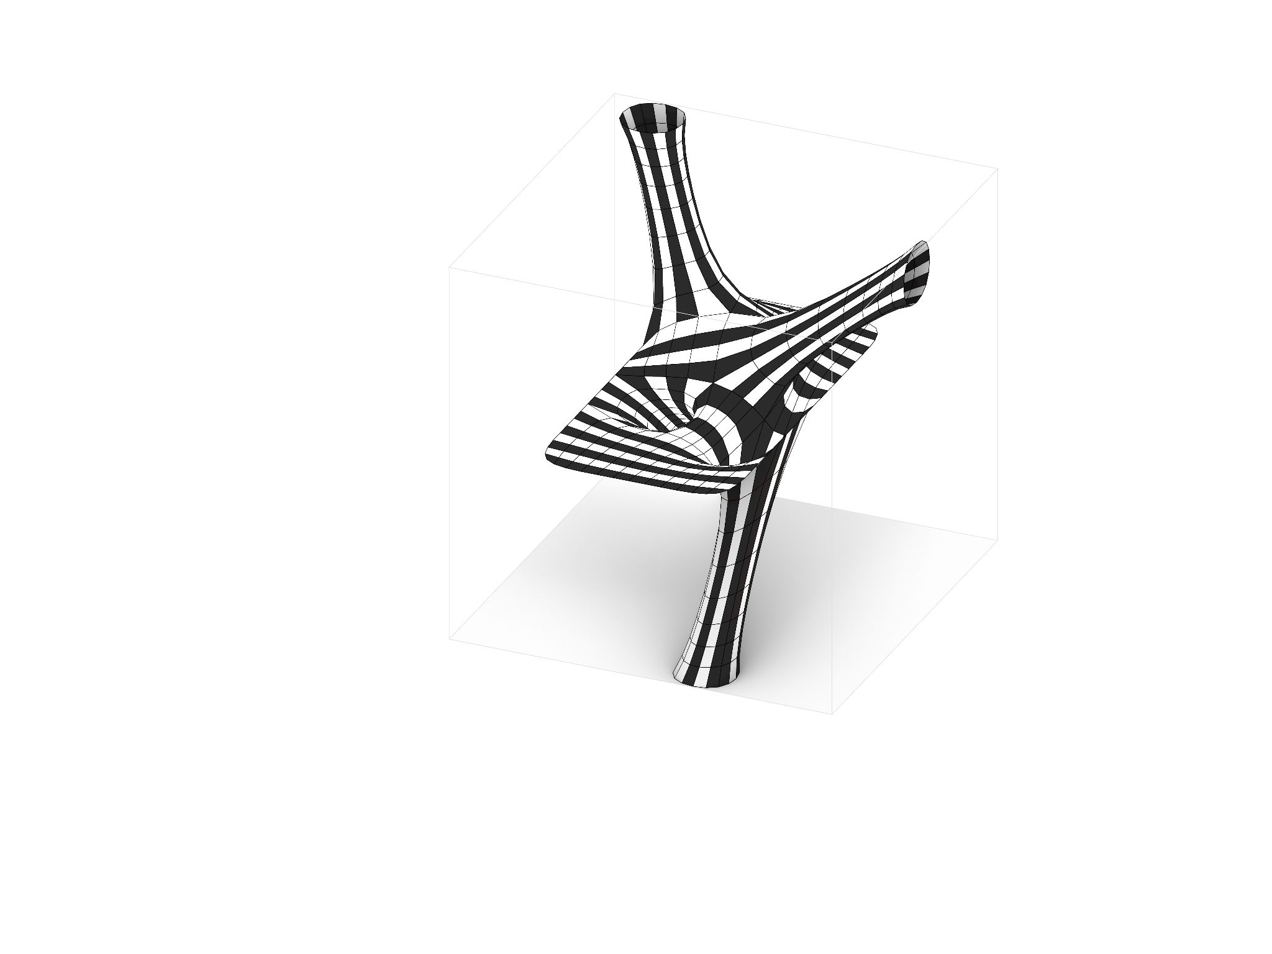
Mesh #2
Initial Geometry
Vertices: 184
Faces: 46
Re-stripped:
# of strips: 76
SOFTer SKIN/ Amy Kim, Andrea Najera, Shamanth Thenkan

Slide 15
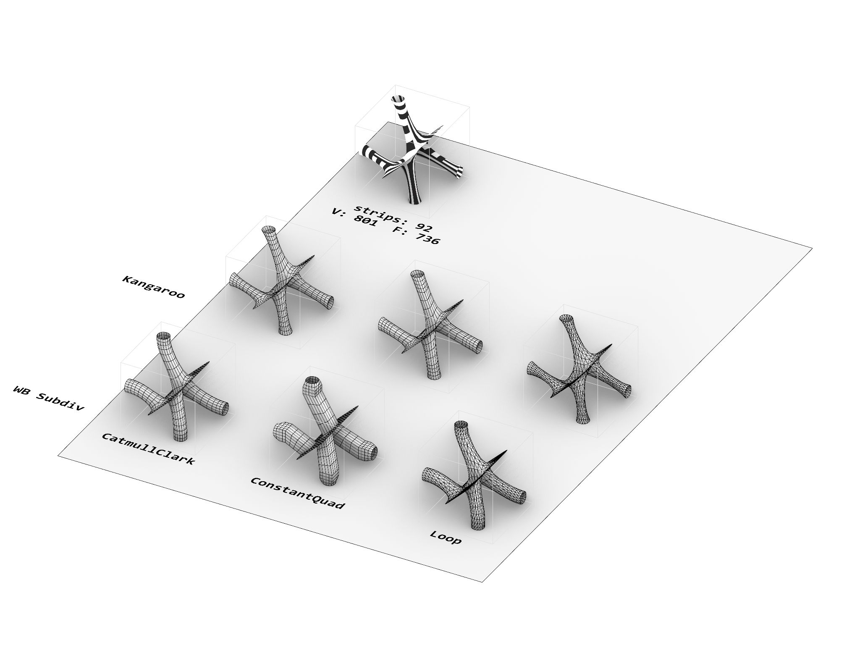
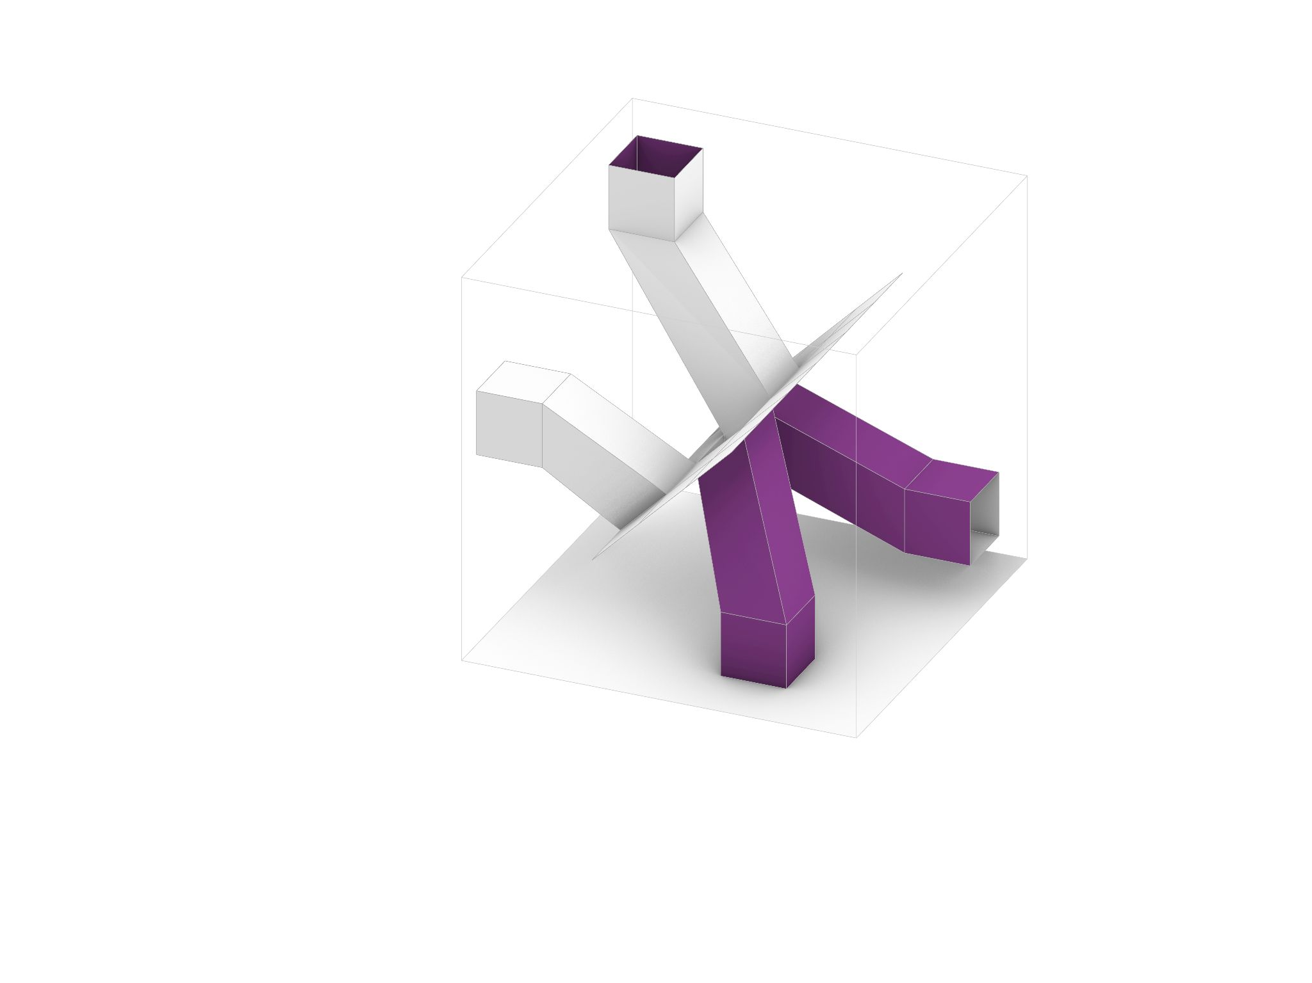
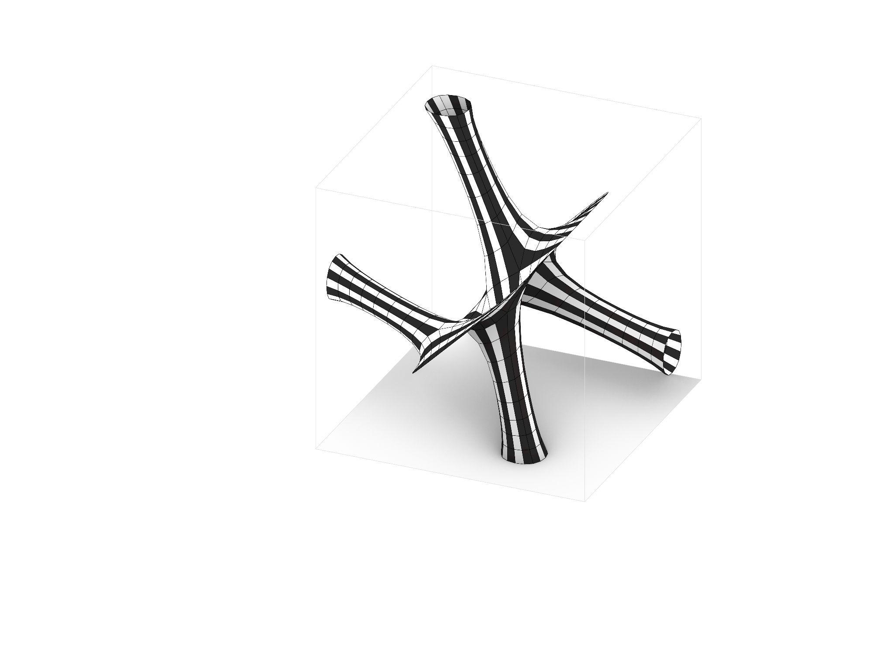
Mesh #3
Initial Geometry
Vertices: 184
Faces: 46
Re-stripped:
# of strips: 68
SOFTer SKIN/ Amy Kim, Andrea Najera, Shamanth Thenkan

Slide 16

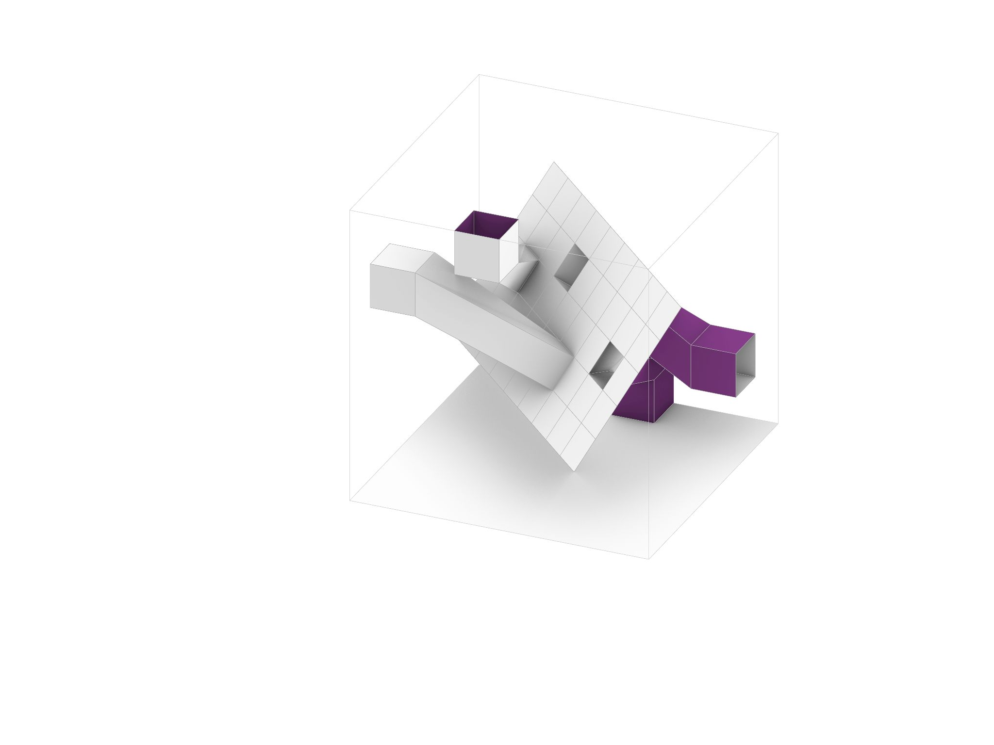
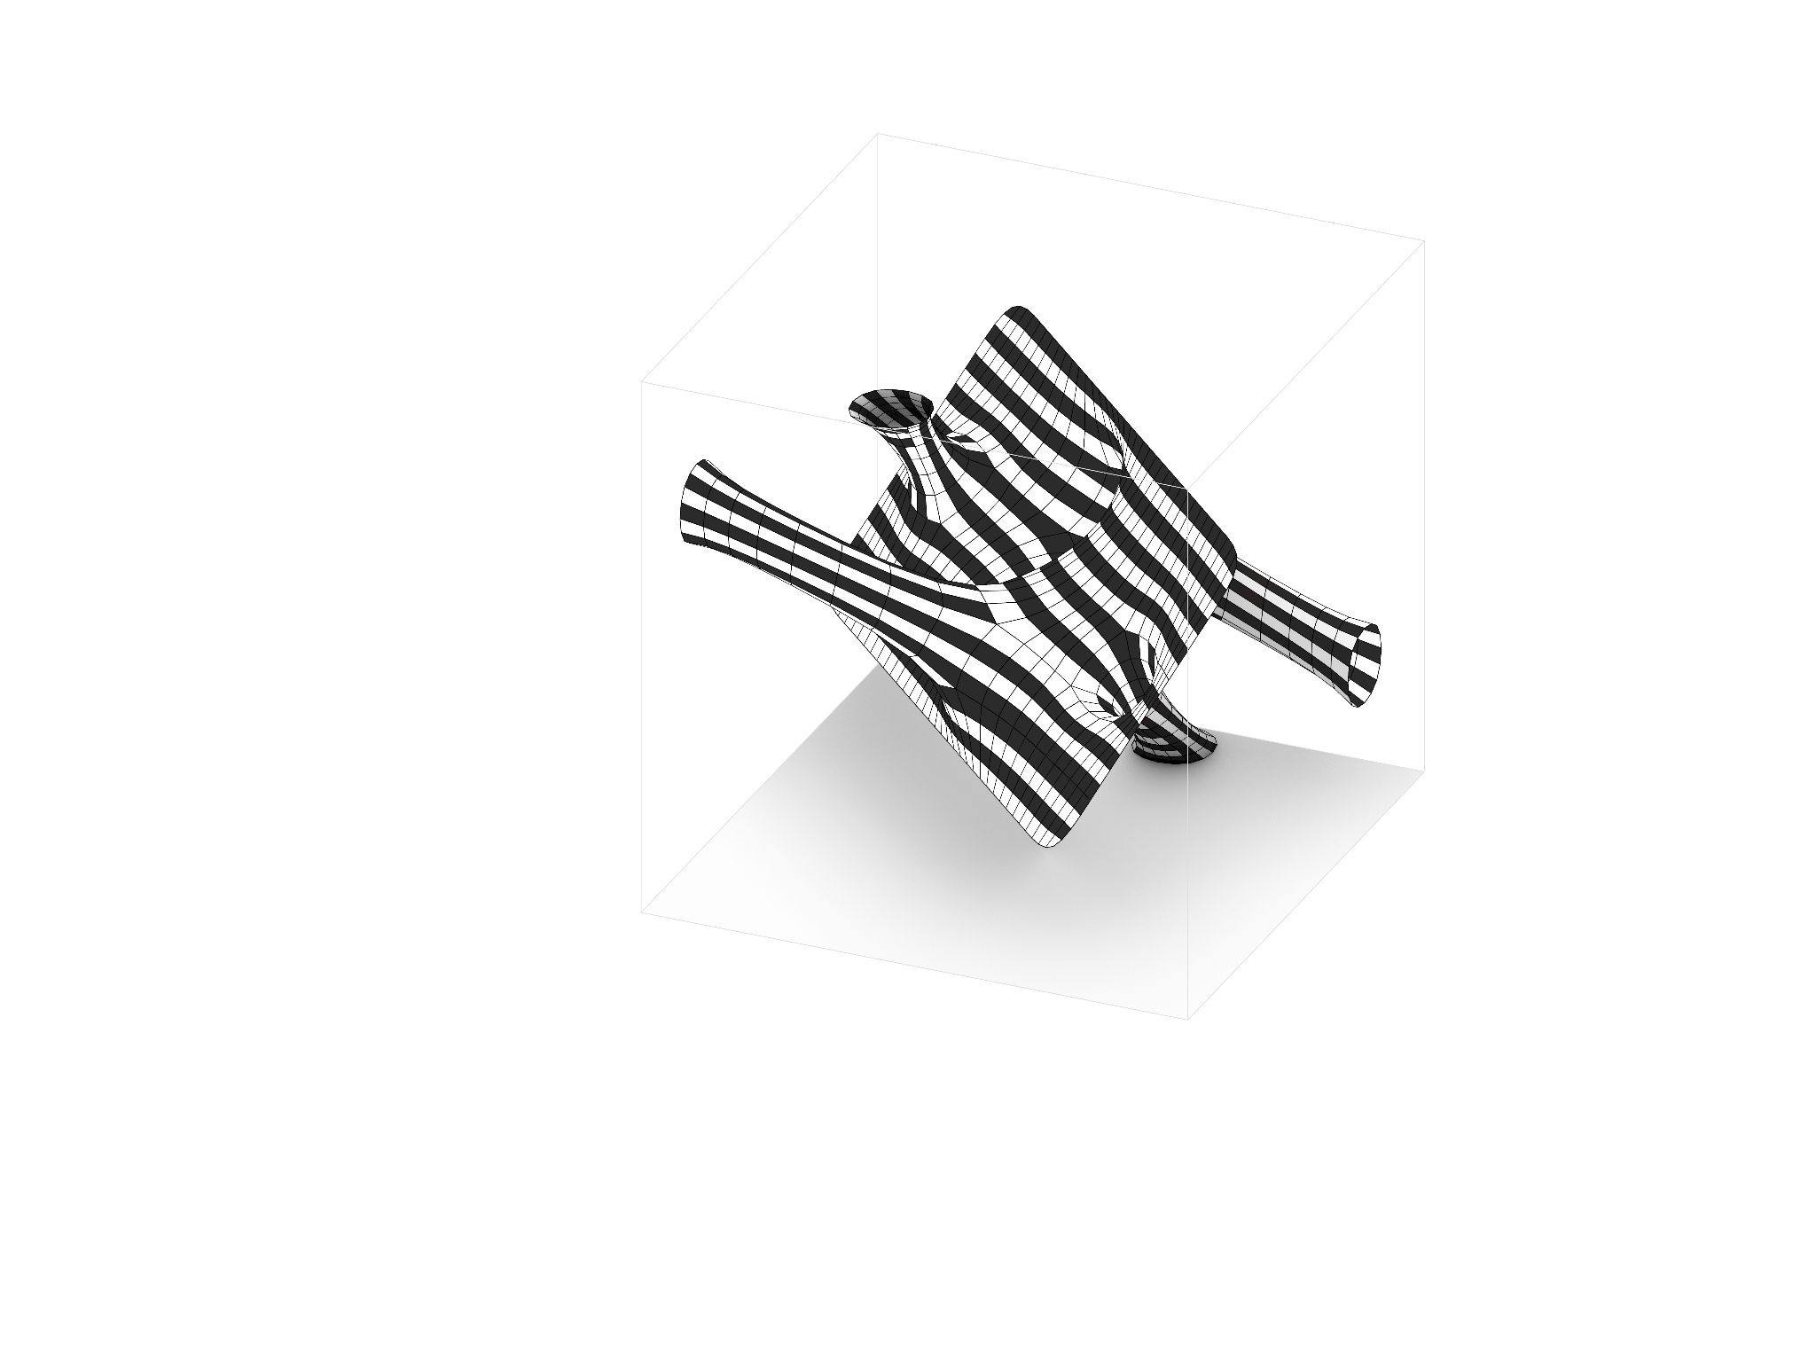
Mesh #4
Initial Geometry
Vertices: 292
Faces:73
Re-stripped:
# of strips: 80
SOFTer SKIN/ Amy Kim, Andrea Najera, Shamanth Thenkan

Slide 17
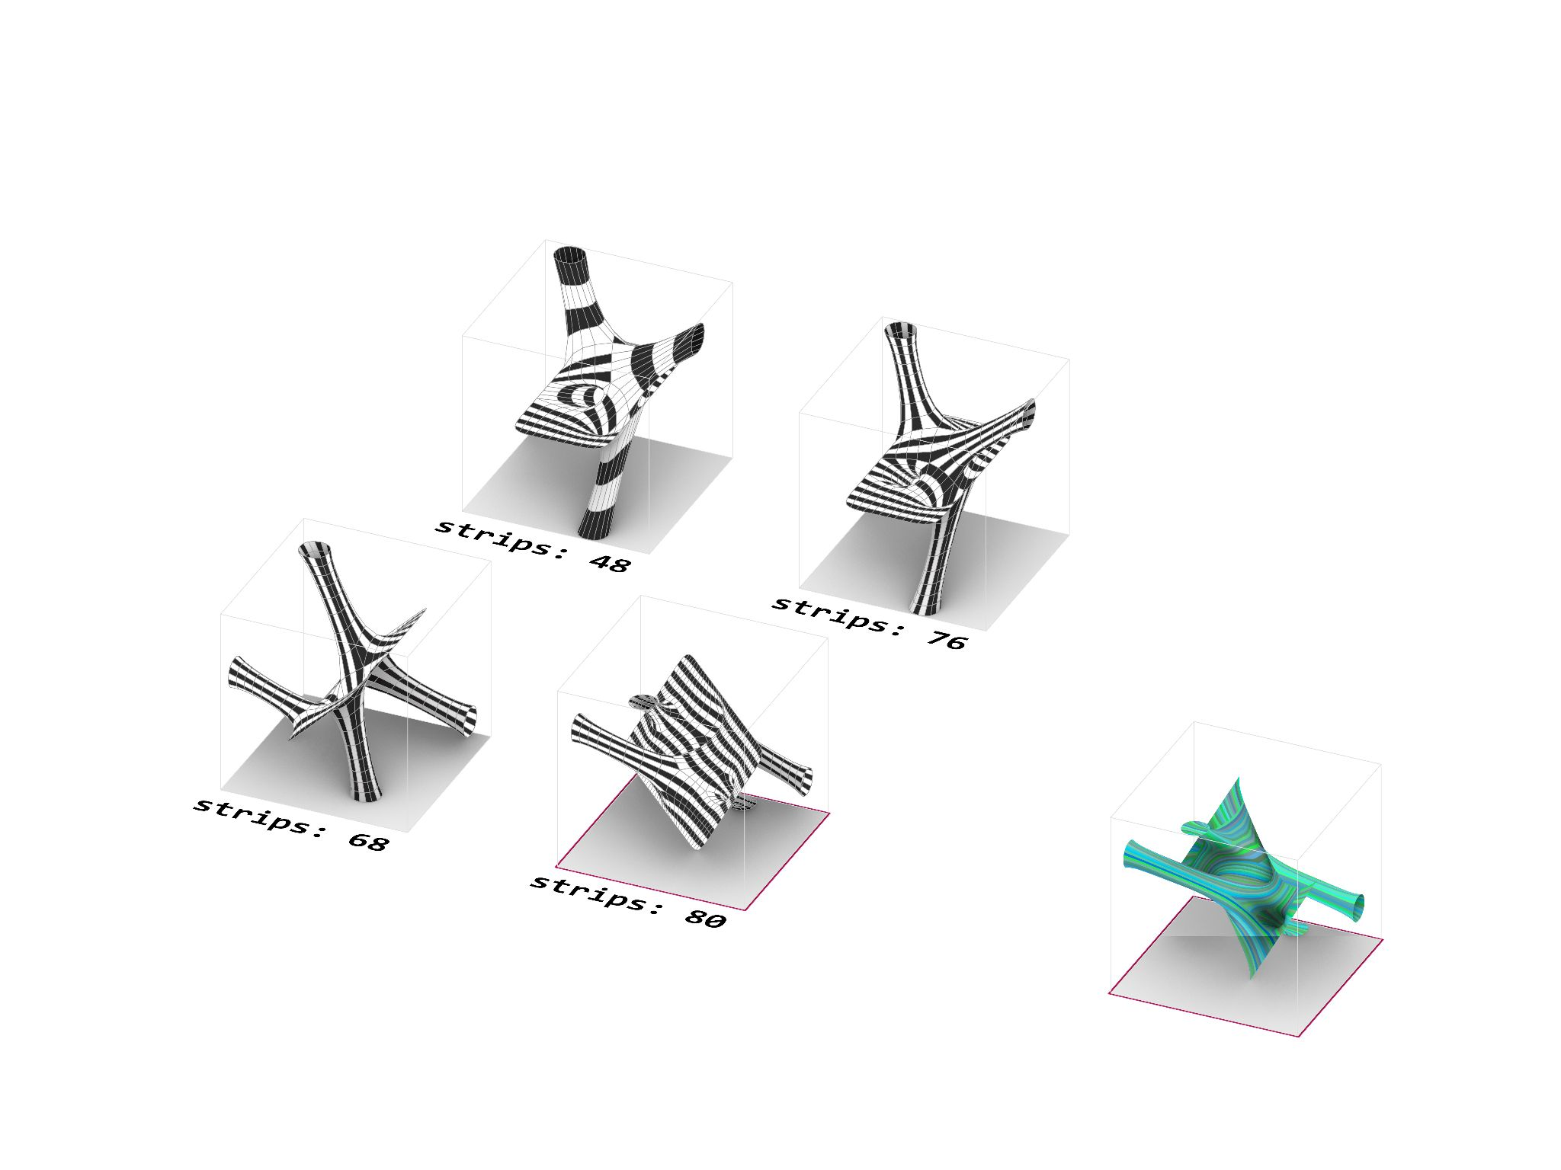
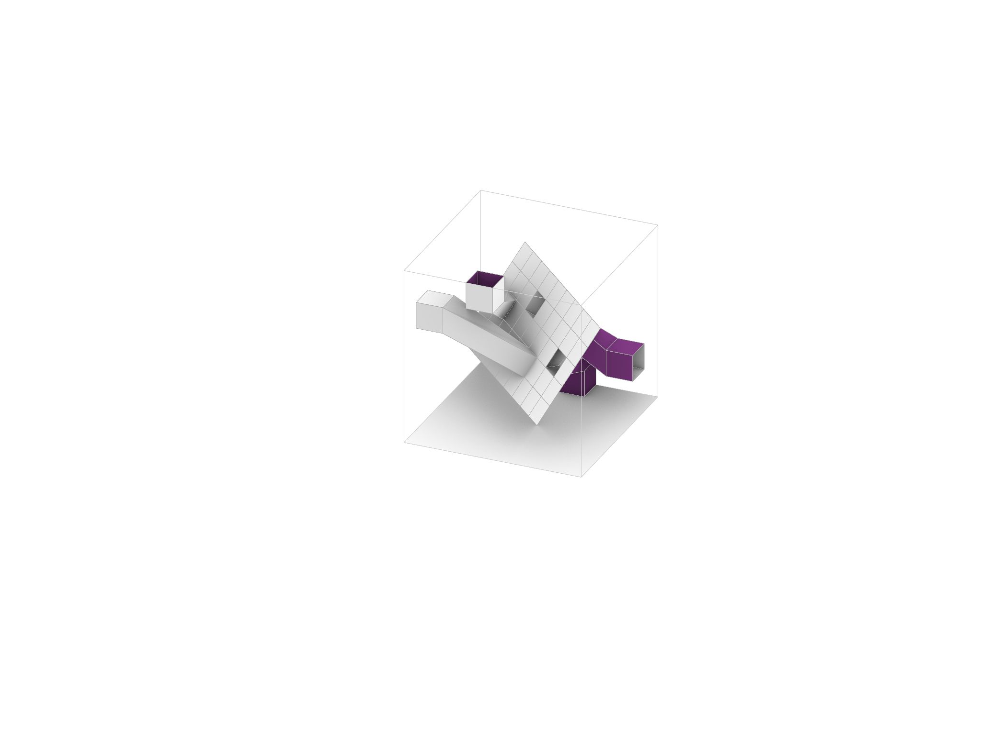
3 - FURTHER DEVELOPMENT
Surface-to-solid mesh geometries provided more options of stripping. We chose mesh #4 to do further explorations.
SOFTer SKIN/ Amy Kim, Andrea Najera, Shamanth Thenkan

Slide 18
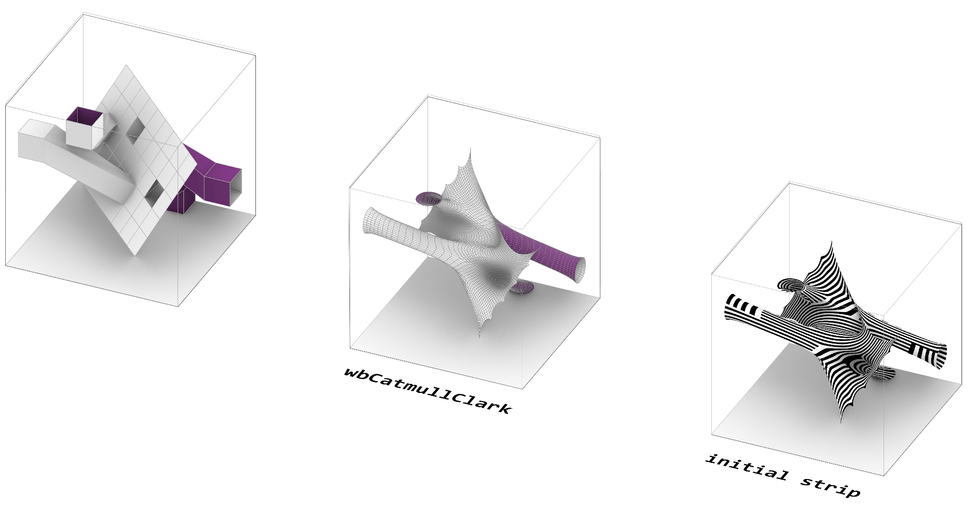
3 - INITIAL STRIPPING
Initial iteration of the stripping carry 232 strips. We begin exploring method of stripping that carries less strips and renders the surface to appear ‘smoother’ or ‘softer’. .
SOFTer SKIN/ Amy Kim, Andrea Najera, Shamanth Thenkan

Slide 19
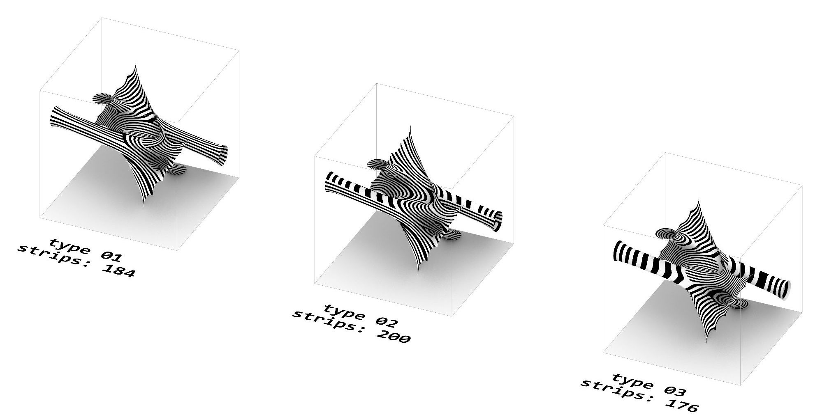
3 - STRIPS ITERATIONS
Surface-to-solid mesh geometries provided more options of stripping. We chose mesh #4 to do further explorations.
SOFTer SKIN/ Amy Kim, Andrea Najera, Shamanth Thenkan

Slide 20
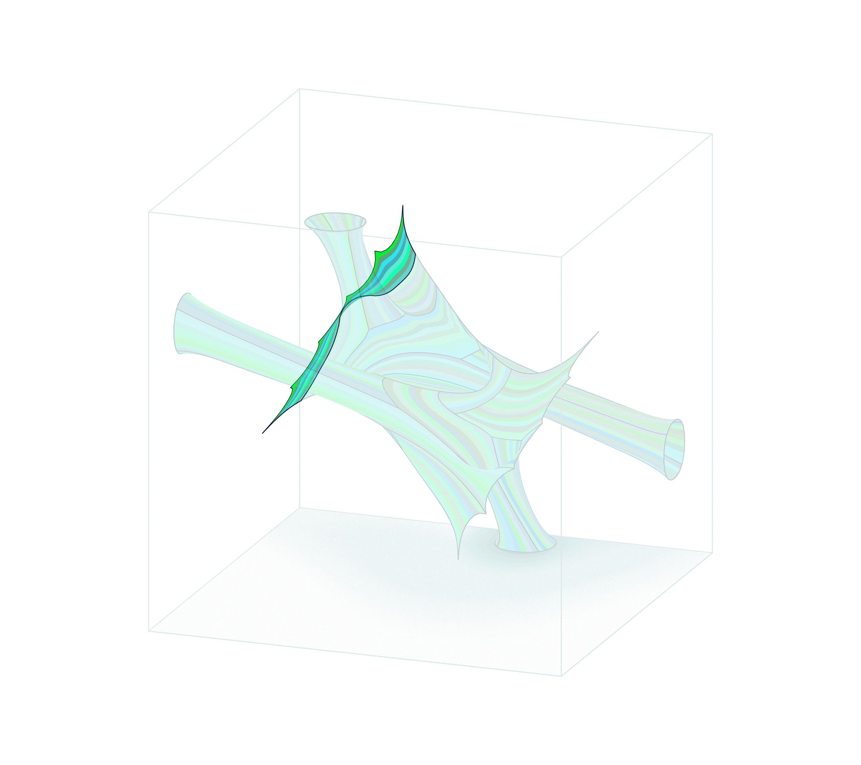
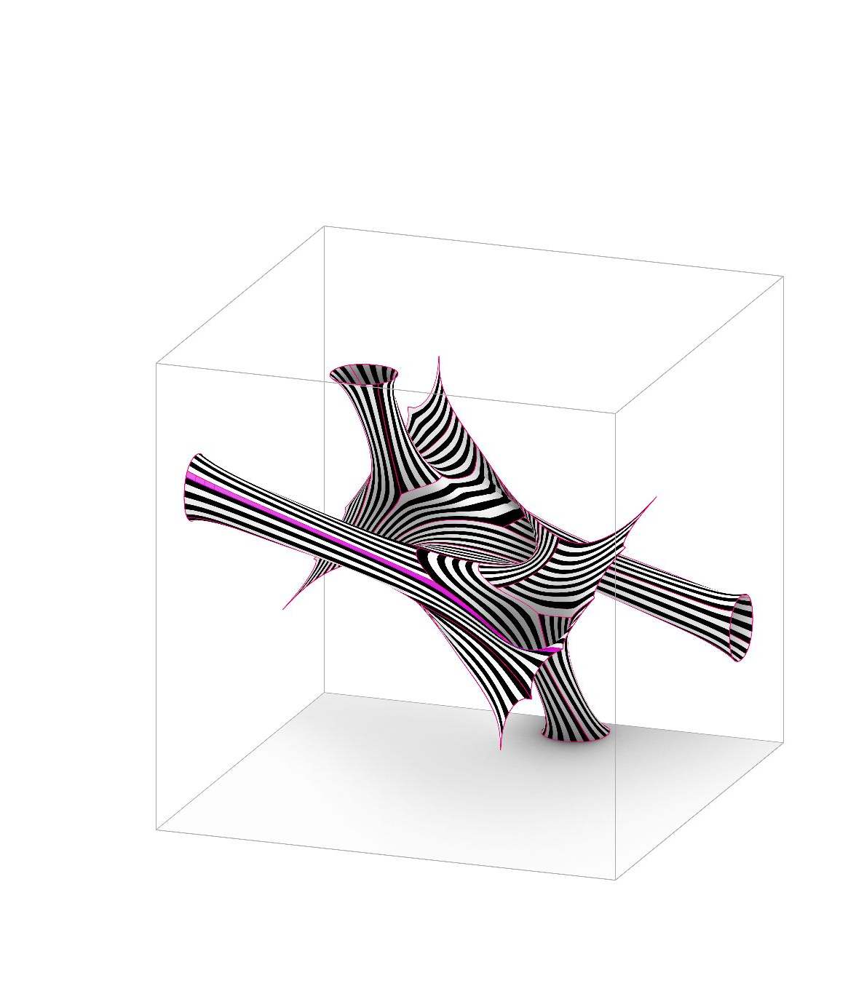
TYPE 01
Number of Grouped Strips: 21
Longest strip : 5.3 m
longest strips
3 - STRIPPING FOR SOFTNESS
184 strips can be grouped by direction of their grain, resulting in 21 groups of strips. The longest strip is approximately 5.3m.
SOFTer SKIN/ Amy Kim, Andrea Najera, Shamanth Thenkan

Slide 21
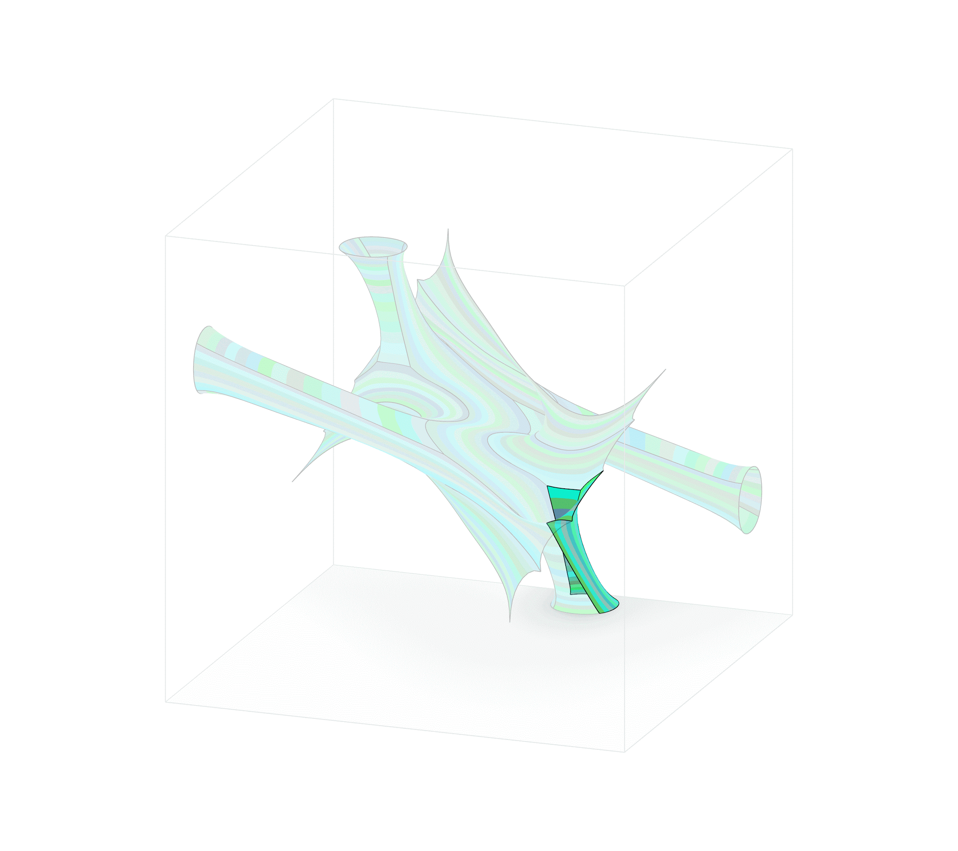
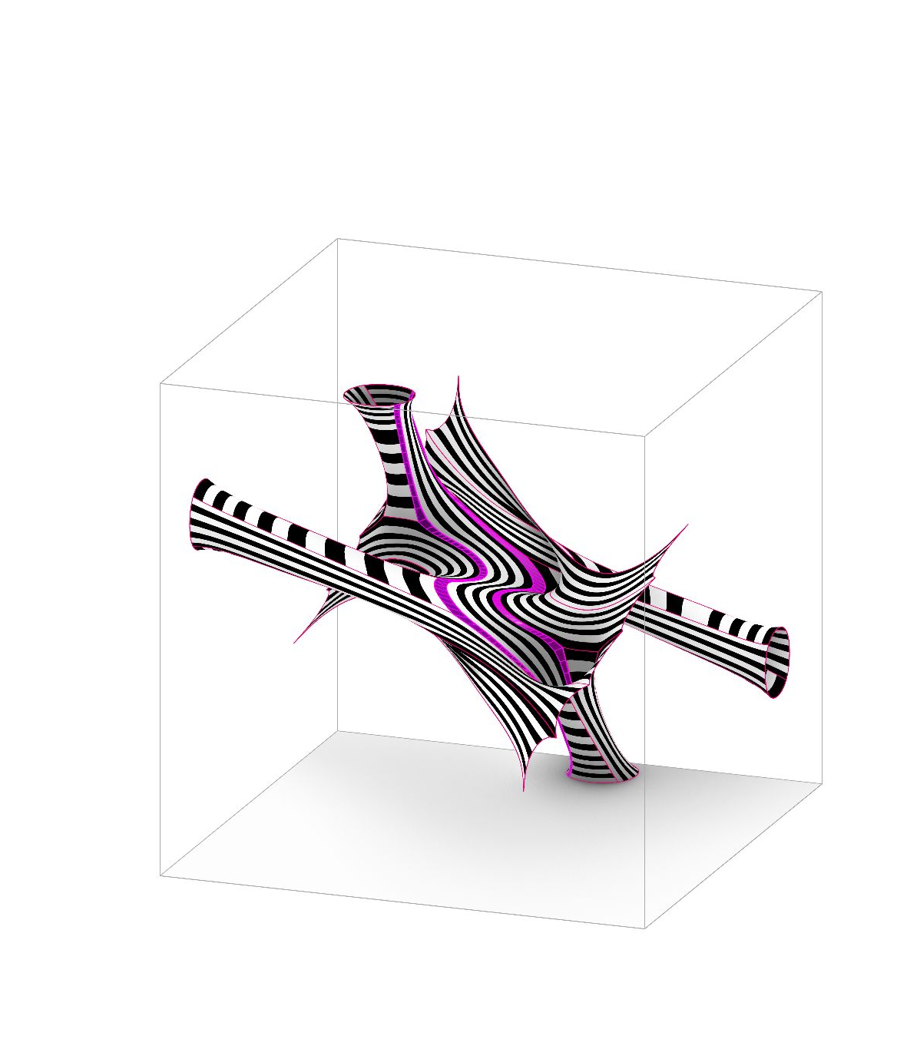
TYPE 02
Number of Grouped Strips: 17
Longest strip : 9.1 m
longest strips
3 - STRIPPING FOR SOFTNESS
Originally 200 strips, Type 2 groups the strips to 17 pieces. The longest strips are approximately 9.1 meters long.
SOFTer SKIN/ Amy Kim, Andrea Najera, Shamanth Thenkan

Slide 22
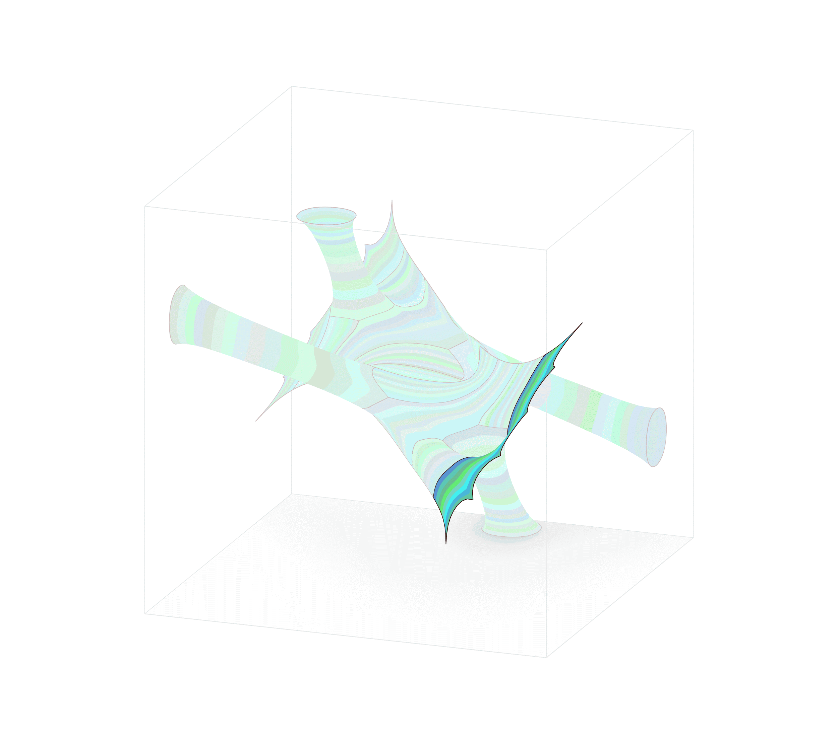
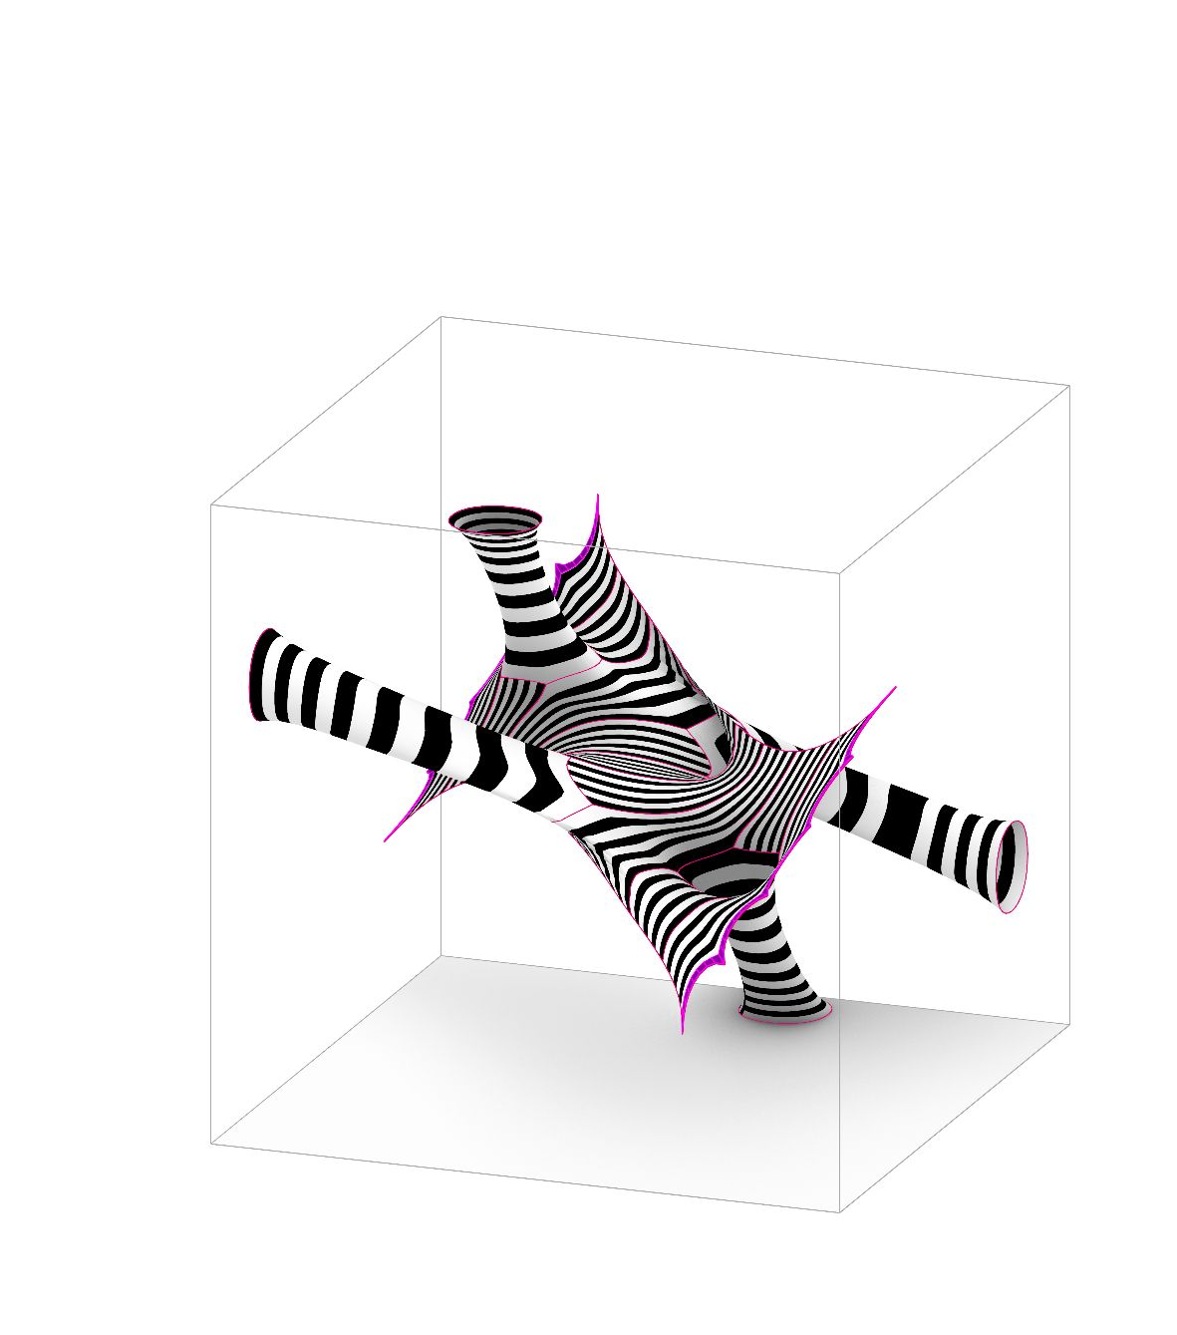
TYPE 03
Number of Grouped Strips: 17
Longest strip : 2.0 m
longest strips
3 - STRIPPING FOR SOFTNESS
This type carries the lowest amount of strips of 176 strips. In the process of grouping them, it results in 17 groups., with the longest strip being shortest amongst three iterations.
SOFTer SKIN/ Amy Kim, Andrea Najera, Shamanth Thenkan

Slide 23
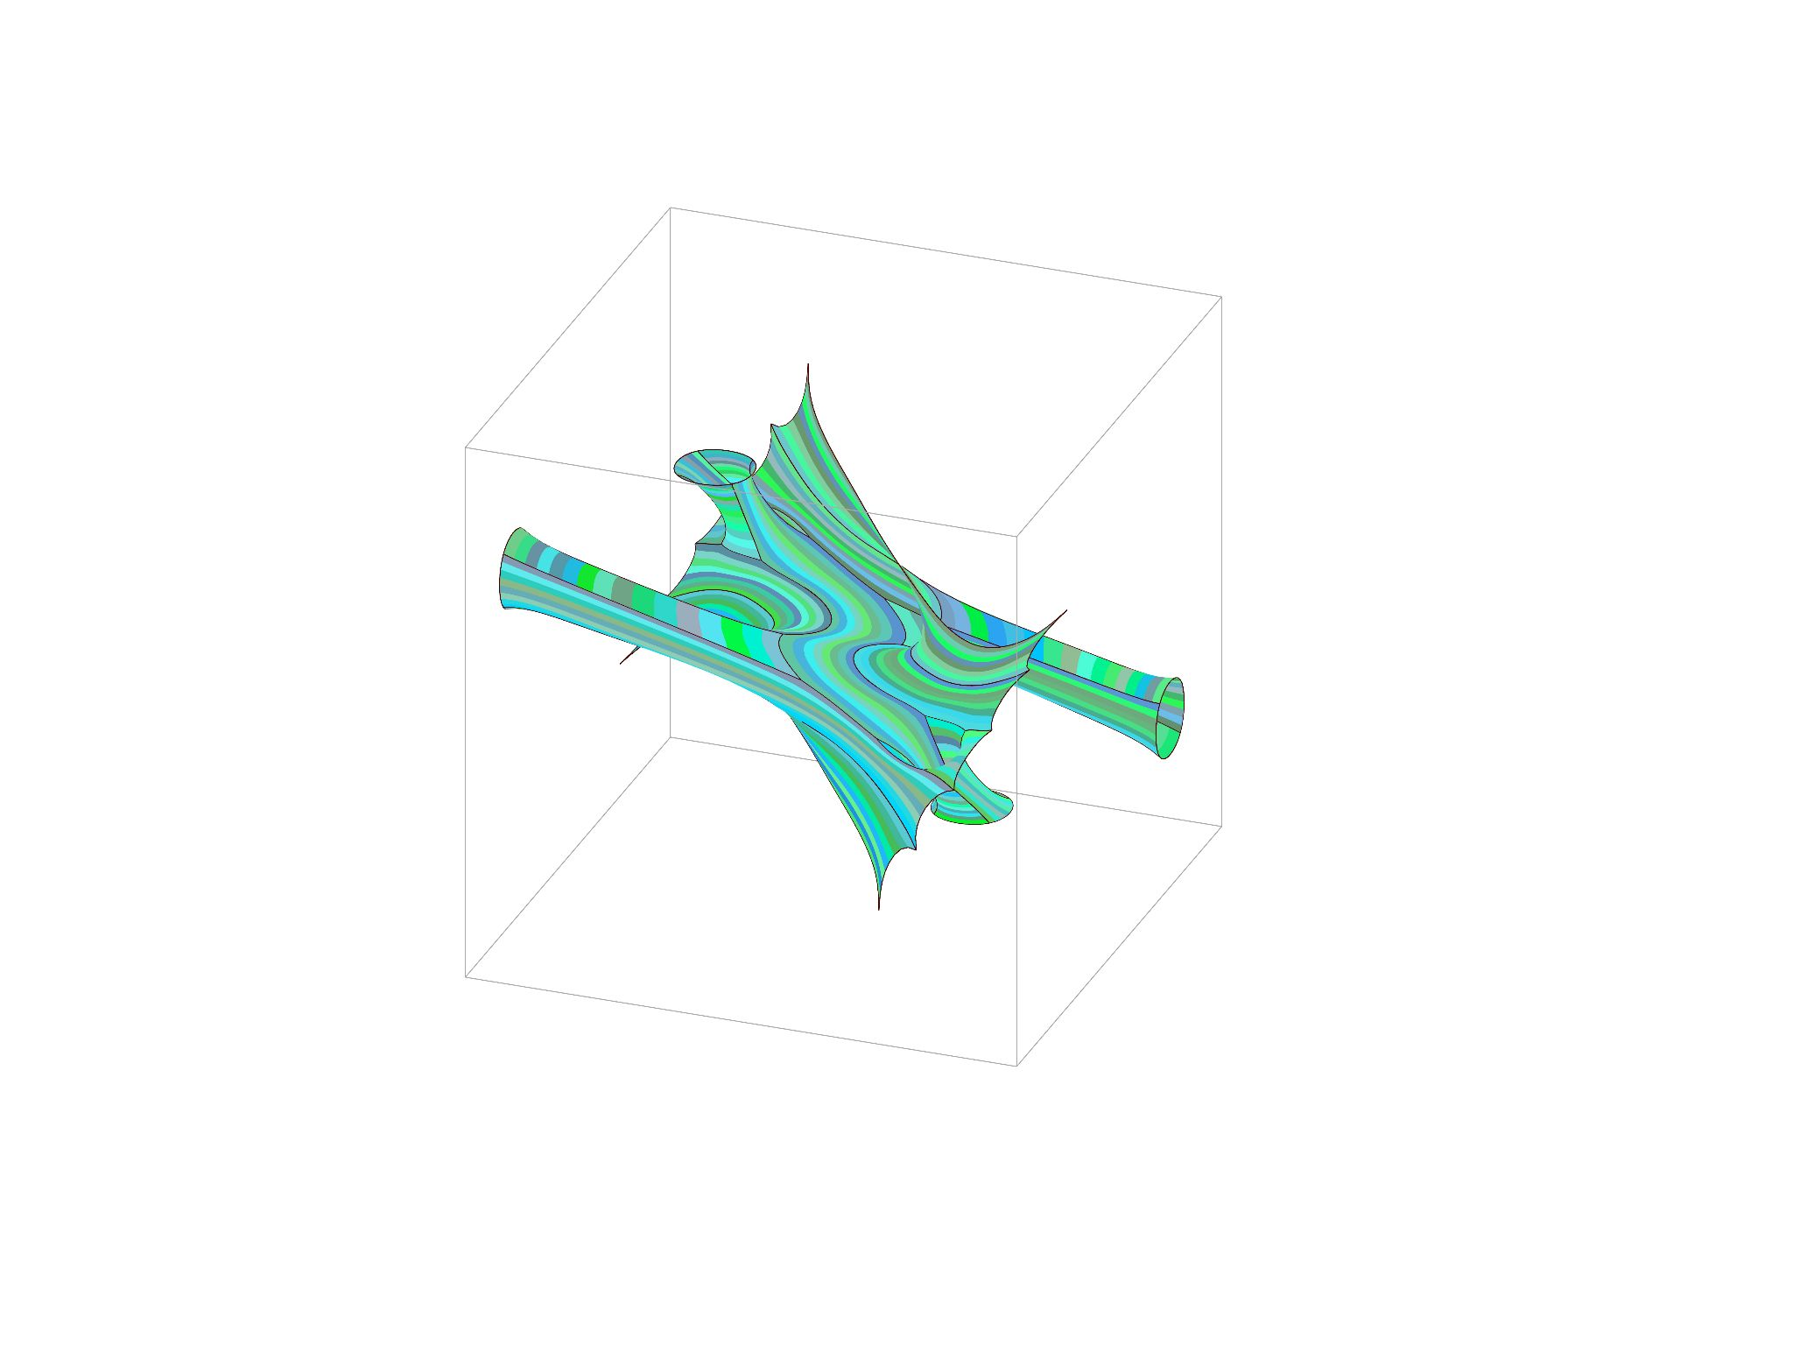
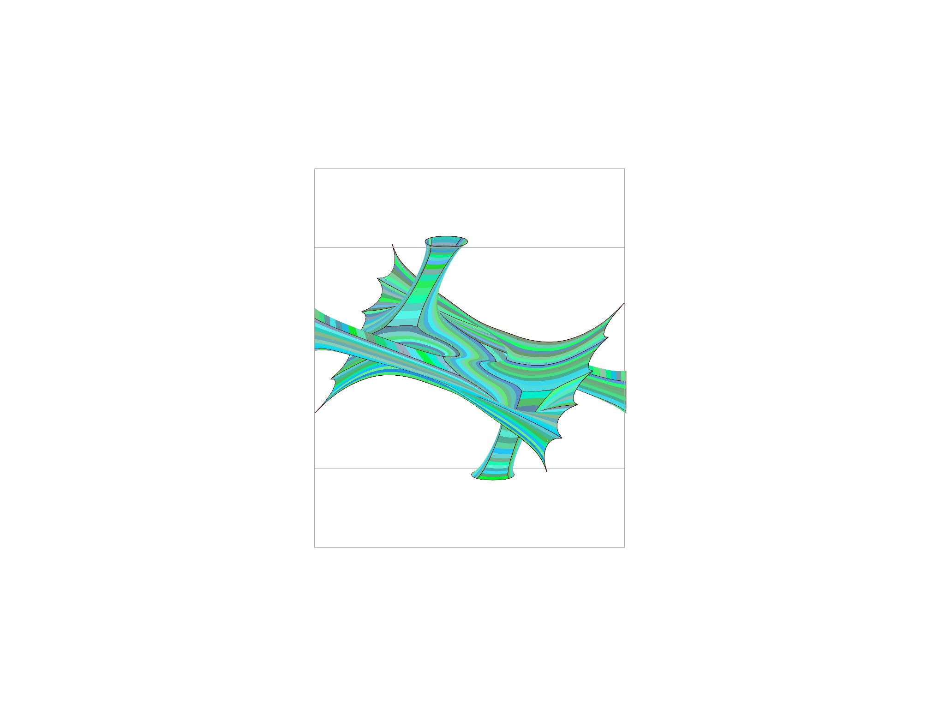
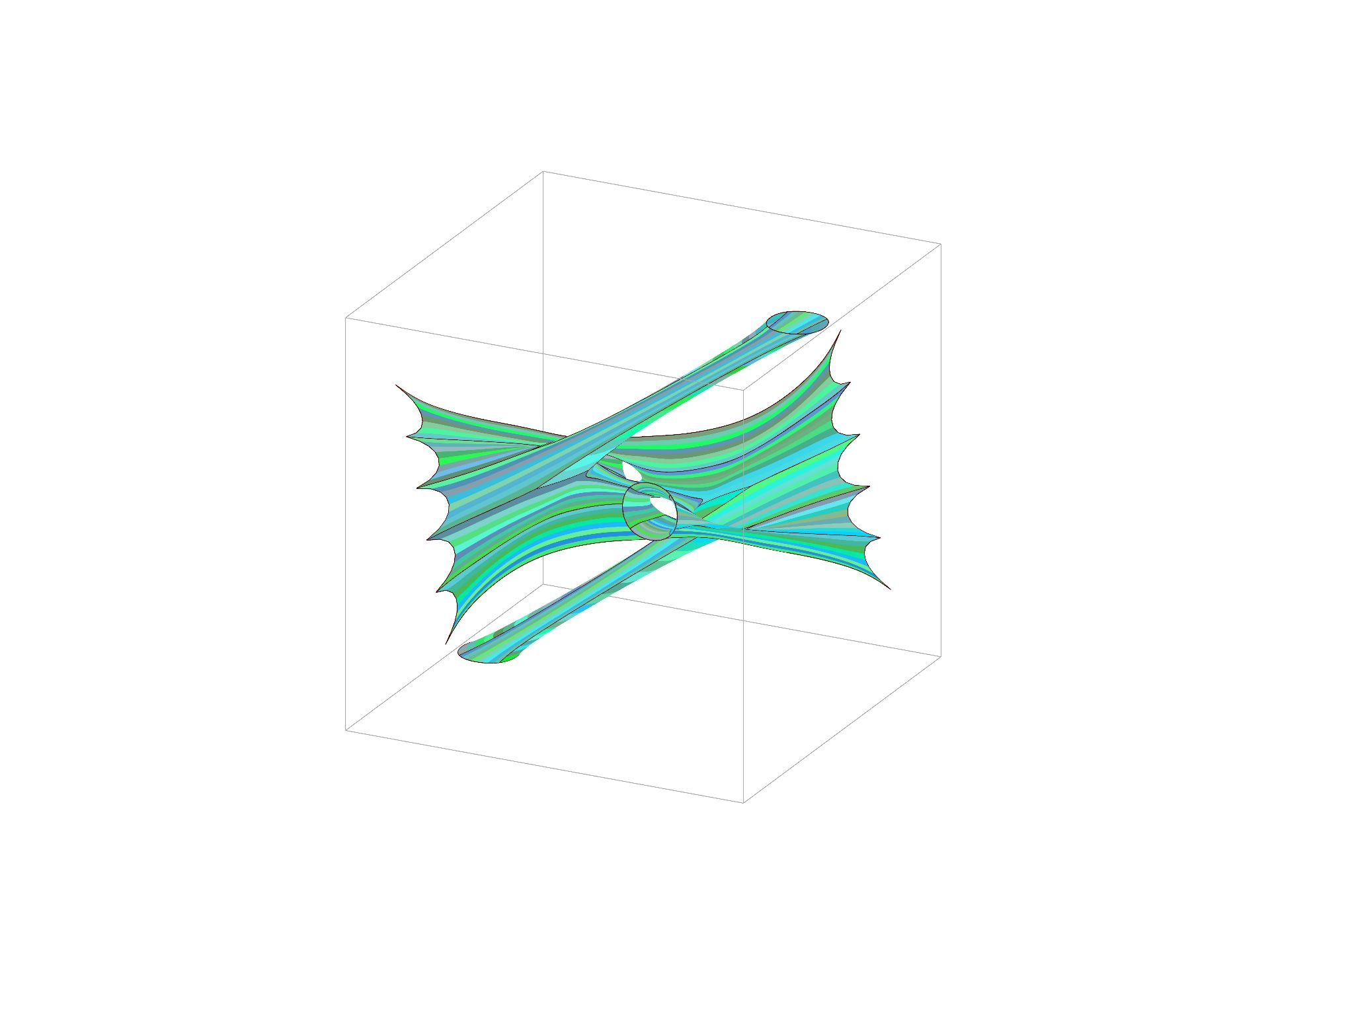
DECIDED
4 - STRIPPING TYPE 02
We chose Type 02 to move forward because of its aesthetics. The fluidity is a result of long strips (maximum of 9.1m) which implied that we will have to use a more flexible material. We were leaning towards the use of fabric.
SOFTer SKIN/ Amy Kim, Andrea Najera, Shamanth Thenkan

Slide 24
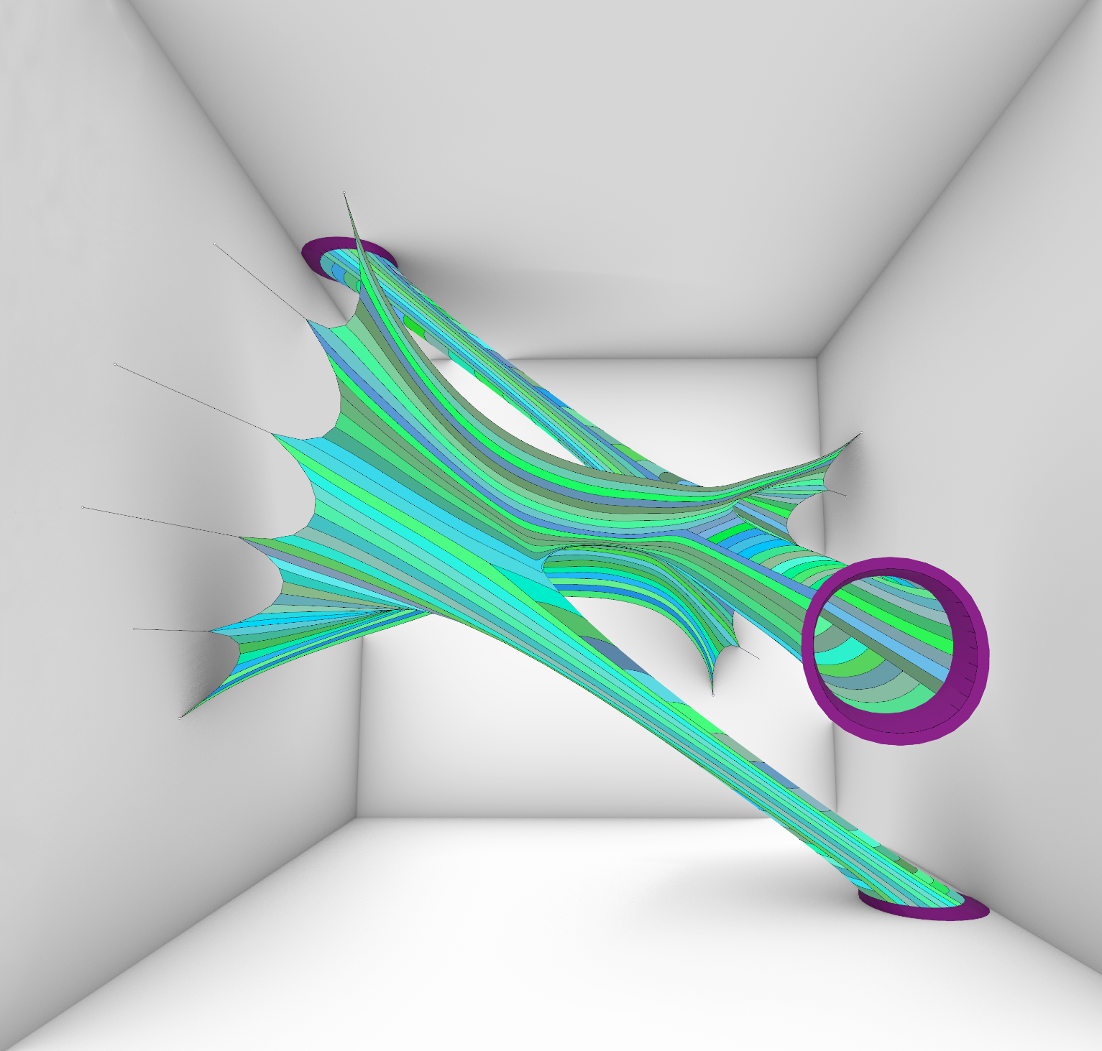
Smooth & relaxed skin

Slide 25
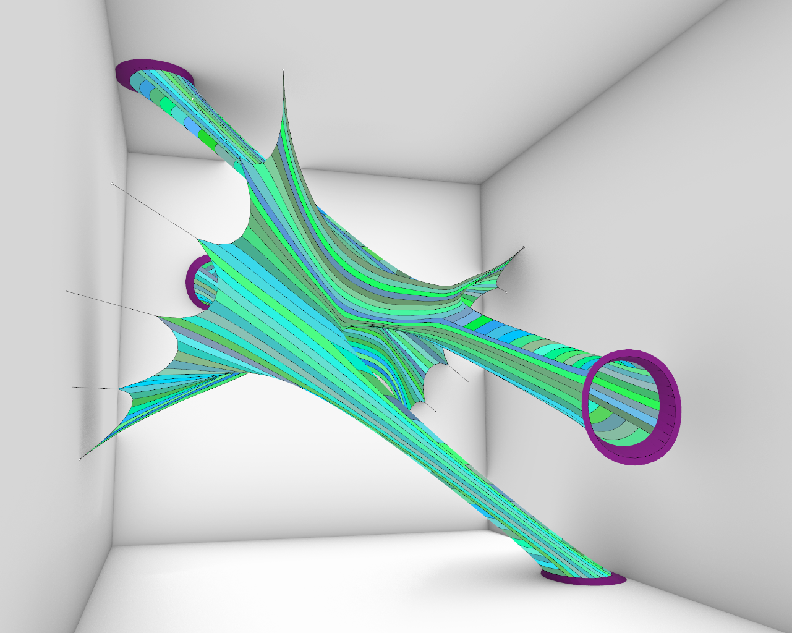
with regular moisturization

Slide 26
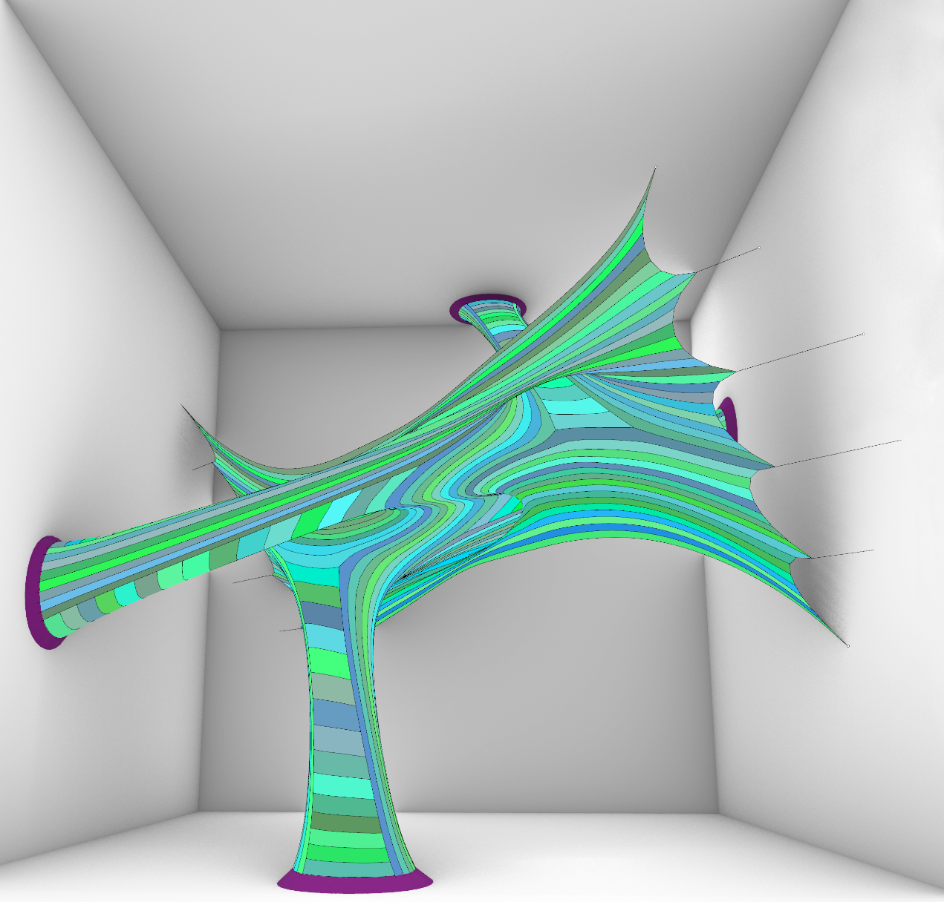
wrinkle free

Slide 27


10 m
50 m
25 m
10 m
50 m
25 m
4 - FABRICATION
Surface-to-solid mesh geometries provided more options of stripping. We chose mesh #4 to do further explorations.
SOFTer SKIN/ Amy Kim, Andrea Najera, Shamanth Thenkan

Slide 28

2.5 m
1 m
0.5 m
4 - FABRICATION
Surface-to-solid mesh geometries provided more options of stripping. We chose mesh type 02 to do further explorations.
SOFTer SKIN/ Amy Kim, Andrea Najera, Shamanth Thenkan

Slide 29

5 m
157 Stripes fits in a cloth roll of 1.2 m x 63.8m
10 m
49 Stripes will have to be custom made
4 - FABRICATION
Surface-to-solid mesh geometries provided more options of stripping. We chose mesh type 02 to do further explorations.
SOFTer SKIN/ Amy Kim, Andrea Najera, Shamanth Thenkan

Slide 30

Thank you.
SOFTer SKIN/ Amy Kim, Andrea Najera, Shamanth Thenkan

